Slide 1
Year 1 Phonic knowledge and the Phonics Screening Check Information 2025
Morley Memorial Primary School

Slide 2
Focus:
Phonic terminology
Which phonemes / graphemes have been taught by the end of Year 1
What is the phonics screening check?
What will the children be expected to do?
How will the data be used?
How can you help?
Correct pronunciation / articulation of phonemes
Notes:
Correct terminology should be introduced from YR onwards.
Children do not have a problem using phonic terminology (in fact they are often very proud of their ability to do so).
However, you are likely to meet resistance from some teachers who consider it ‘over the top’ and unnecessary to teach this vocabulary to children. It is sometimes worth using a numeracy analogy with these staff: we wouldn’t dream of teaching 3-D shapes to children and using the word ‘ball’ instead of ‘sphere’ or ‘box’ instead of cube/cuboid.
The principle with phonic vocabulary is exactly the same – it’s just that we haven’t been used to using these words with children until relatively recently.
Using phonic terminology from the outset ensures accuracy and promotes shared understanding between practitioners and practitioners and children.

Slide 3
Phonic terminology: some definitions
A phoneme is the smallest unit of sound in a word (your mouth stays in one position to make this sound)
A grapheme is the letter, or letters, representing a phoneme
t ai igh
Notes:
Correct terminology should be introduced from YR onwards.
Children do not have a problem using phonic terminology (in fact they are often very proud of their ability to do so).
However, you are likely to meet resistance from some teachers who consider it ‘over the top’ and unnecessary to teach this vocabulary to children. It is sometimes worth using a numeracy analogy with these staff: we wouldn’t dream of teaching 3-D shapes to children and using the word ‘ball’ instead of ‘sphere’ or ‘box’ instead of cube/cuboid.
The principle with phonic vocabulary is exactly the same – it’s just that we haven’t been used to using these words with children until relatively recently.
Using phonic terminology from the outset ensures accuracy and promotes shared understanding between practitioners and practitioners and children.

Slide 4
Phonic terminology: some definitions
A digraph is 2 letters making one phoneme.
cow
A vowel digraph is 2 vowel letters making one phoneme.
moon
A consonant digraph is 2 consonants making one phoneme.
chip
Notes:
Correct terminology should be introduced from YR onwards.
Children do not have a problem using phonic terminology (in fact they are often very proud of their ability to do so).
However, you are likely to meet resistance from some teachers who consider it ‘over the top’ and unnecessary to teach this vocabulary to children. It is sometimes worth using a numeracy analogy with these staff: we wouldn’t dream of teaching 3-D shapes to children and using the word ‘ball’ instead of ‘sphere’ or ‘box’ instead of cube/cuboid.
The principle with phonic vocabulary is exactly the same – it’s just that we haven’t been used to using these words with children until relatively recently.
Using phonic terminology from the outset ensures accuracy and promotes shared understanding between practitioners and practitioners and children.

Slide 5
Phonic terminology: some definitions
A split digraph is 2 vowels making one phoneme with a consonant in between.
spine - i_e
A trigraph is 3 letters making one phoneme.
night
Notes:
Correct terminology should be introduced from YR onwards.
Children do not have a problem using phonic terminology (in fact they are often very proud of their ability to do so).
However, you are likely to meet resistance from some teachers who consider it ‘over the top’ and unnecessary to teach this vocabulary to children. It is sometimes worth using a numeracy analogy with these staff: we wouldn’t dream of teaching 3-D shapes to children and using the word ‘ball’ instead of ‘sphere’ or ‘box’ instead of cube/cuboid.
The principle with phonic vocabulary is exactly the same – it’s just that we haven’t been used to using these words with children until relatively recently.
Using phonic terminology from the outset ensures accuracy and promotes shared understanding between practitioners and practitioners and children.

Slide 6
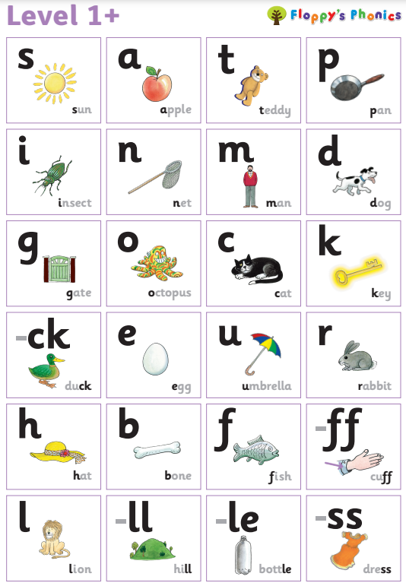
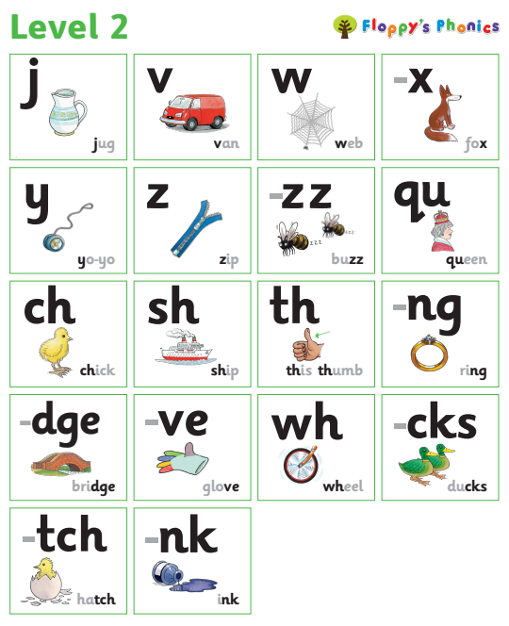
Floppy’s Phonics
Which phonemes / graphemes have been taught by the end of Year 1:
In Reception the first phonemes taught are the alphabet represented mostly by single letter graphemes and some double letters. They then learn consonant blends which form the beginning and ends of words.
Notes:
Correct terminology should be introduced from YR onwards.
Children do not have a problem using phonic terminology (in fact they are often very proud of their ability to do so).
However, you are likely to meet resistance from some teachers who consider it ‘over the top’ and unnecessary to teach this vocabulary to children. It is sometimes worth using a numeracy analogy with these staff: we wouldn’t dream of teaching 3-D shapes to children and using the word ‘ball’ instead of ‘sphere’ or ‘box’ instead of cube/cuboid.
The principle with phonic vocabulary is exactly the same – it’s just that we haven’t been used to using these words with children until relatively recently.
Using phonic terminology from the outset ensures accuracy and promotes shared understanding between practitioners and practitioners and children.

Slide 7
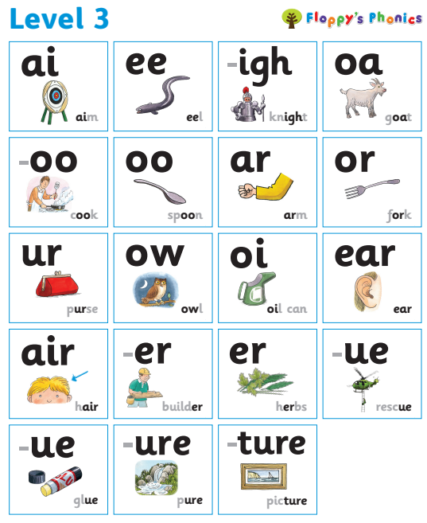
Which phonemes / graphemes have been taught by the end of Year 1:
Also in Reception different vowel sounds are learnt, both digraphs and trigraphs.
Notes:
Correct terminology should be introduced from YR onwards.
Children do not have a problem using phonic terminology (in fact they are often very proud of their ability to do so).
However, you are likely to meet resistance from some teachers who consider it ‘over the top’ and unnecessary to teach this vocabulary to children. It is sometimes worth using a numeracy analogy with these staff: we wouldn’t dream of teaching 3-D shapes to children and using the word ‘ball’ instead of ‘sphere’ or ‘box’ instead of cube/cuboid.
The principle with phonic vocabulary is exactly the same – it’s just that we haven’t been used to using these words with children until relatively recently.
Using phonic terminology from the outset ensures accuracy and promotes shared understanding between practitioners and practitioners and children.

Slide 8
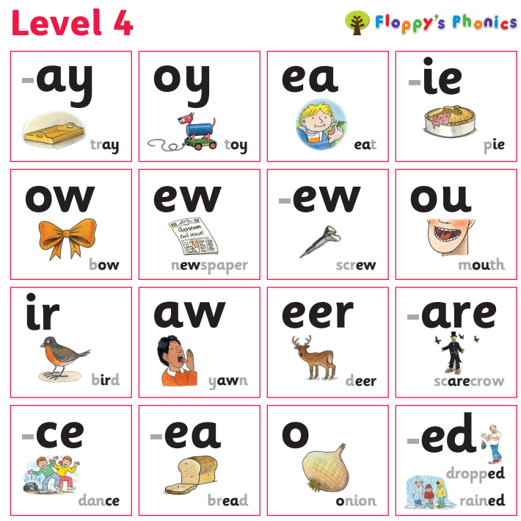
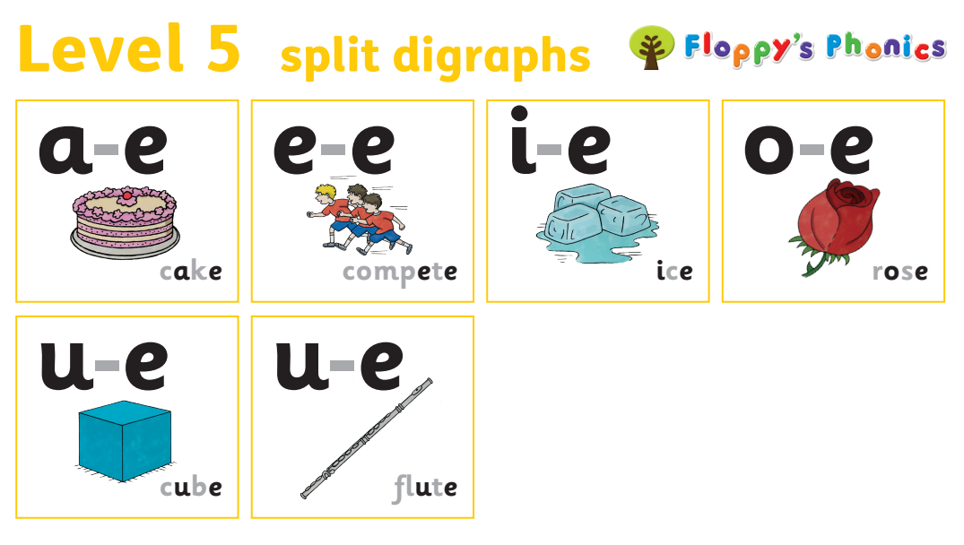
Which phonemes / graphemes have been taught by the end of Year 1:
In Year 1 children learn some new sounds and split digraphs.
Notes:
Correct terminology should be introduced from YR onwards.
Children do not have a problem using phonic terminology (in fact they are often very proud of their ability to do so).
However, you are likely to meet resistance from some teachers who consider it ‘over the top’ and unnecessary to teach this vocabulary to children. It is sometimes worth using a numeracy analogy with these staff: we wouldn’t dream of teaching 3-D shapes to children and using the word ‘ball’ instead of ‘sphere’ or ‘box’ instead of cube/cuboid.
The principle with phonic vocabulary is exactly the same – it’s just that we haven’t been used to using these words with children until relatively recently.
Using phonic terminology from the outset ensures accuracy and promotes shared understanding between practitioners and practitioners and children.

Slide 9
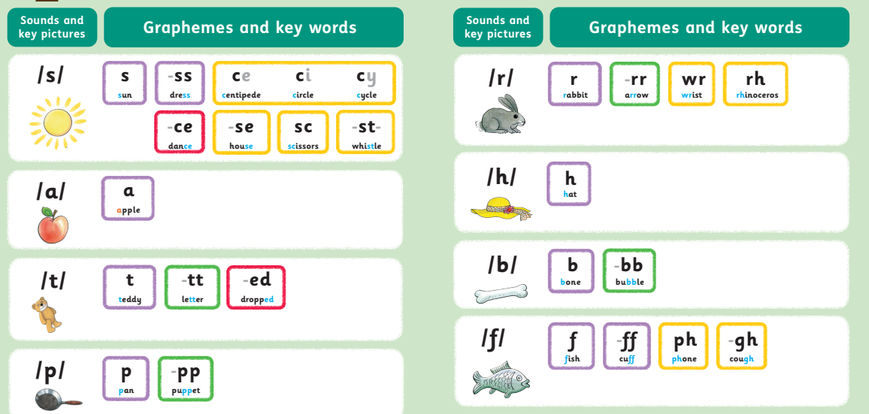
Which phonemes / graphemes have been taught by the end of Year 1:
Next in Year 1 children progress to discover that some of the graphemes that they have learnt have more than one phoneme. E.g. ea bead / head. By the end of Year 1 all the alternative graphemes for all phonemes are taught.
There are lots of these - we will send every child home with a full sound mat.
Notes:
Correct terminology should be introduced from YR onwards.
Children do not have a problem using phonic terminology (in fact they are often very proud of their ability to do so).
However, you are likely to meet resistance from some teachers who consider it ‘over the top’ and unnecessary to teach this vocabulary to children. It is sometimes worth using a numeracy analogy with these staff: we wouldn’t dream of teaching 3-D shapes to children and using the word ‘ball’ instead of ‘sphere’ or ‘box’ instead of cube/cuboid.
The principle with phonic vocabulary is exactly the same – it’s just that we haven’t been used to using these words with children until relatively recently.
Using phonic terminology from the outset ensures accuracy and promotes shared understanding between practitioners and practitioners and children.

Slide 10
What is the phonics screening check?
The phonics screening check is a statutory assessment for all children in Year 1.
The phonics screening check is planned to take place during the week commencing 9th June 2025.
The focus of the Phonics Screening Check is to test children’s understanding of grapheme-phoneme correspondence and their ability to use this to decode real and pseudo (nonsense) words.
The phonics screening check comprises of a list of 40 real and pseudo words that children read one-to-one to their teacher in a quiet area of the school.
There is no time limit but the phonics screening check normally takes up to 10 minutes for each child.

Slide 11
What will the children be expected to do?
Children will be told they are doing a sounding out and blending quiz rather than a reading test.
They will be asked to read the real and nonsense words aloud.
Children can ‘sound out’ before trying to say the whole word if this helps them.
It will be pointed out that if there is a picture of an alien next to the word it isn’t a real word.
Children will be provided with a pencil and may add sound buttons to each word if they choose to.

Slide 12
The phonics screening check will be constructed of 20 real words and 20 pseudo-words.
The pseudo words will be presented with a picture of an alien next to them.

Slide 13
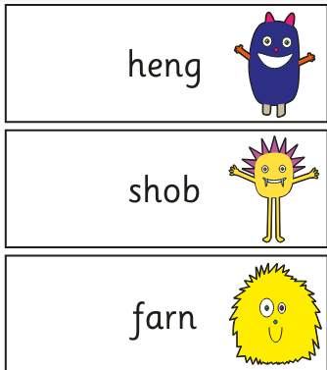

Slide 14
What type of words will the Phonics Screening Check contain?
The check will begin with simple words and moves on to more complex words. There will be:
Simple CVC words for example the pseudo word, v-a-p
Words with consonant digraphs such as ch-i-ll
Words with vowel digraphs such as w-ee-k or h-oo-k-s
Words with adjacent consonants such as s-t-ar-t or pseudo words such as j-ou-n-d
Words containing split digraphs such as ph-o-n-e or s-l-i-d-e
Words with alternative spellings of phonemes such as d-ay and t-r-ai-n-s
Pseudo words that can be pronounced in alternative ways for example v-oo-n (both will be marked correctly)
Two- syllable words such as d-e-n/t-i-s-t.

Slide 15
How will the data be used?
The data will be used in the following ways:
Individual children’s results will be sent home to parents with their annual report, so that parents are kept informed about their child’s progress.
Results will be recorded in the school summative assessment database where they will be available to the teaching staff to use to support children’s next steps in learning.
The results will be reported to The Local Authority for data analysis and monitoring and for use in Ofsted inspections.
National and Local Authority results will be reported to track standards over time and allow schools to benchmark the performance of their children.

Slide 16
How can you help?
Encourage your child to ‘sound out’ when reading or writing words they are unsure of.
Revise sounds from the sound mat.
Ensure your child has plenty of sleep and breakfast the week beginning the Phonics Screening Check.

Slide 17
Online Phonics Resources
The following websites are recommended by the school but we are not responsible for their content. Please always supervise your child when they use the following websites:
Phonics Play - Free Parents Resources
http://www.phonicsplay.co.uk/Phase5Menu.htm
Teach your monster to read - Computer version is 100% free
https://www.teachyourmonstertoread.com/
Floppy’s phonics practice zone
https://www.oxfordowl.co.uk/
There is a guide for logging into this on Google Classroom. Log in details are
username: yr1crimson password: Morley
username: yr1scarlet password: Morley

Slide 18
Finally, remember, using phonics is only one strategy needed to become a fluent reader.
Please continue to read with your child each evening and encourage them to:
Re-read as they go to check it makes sense
Use pictures for clues
Try to remember the shape of words
Ask and answer questions about the book
And most importantly enjoy reading!

