Slide 1

Welcome to Year 6
Information Session for Parents and Carers
Thursday 12th September
www.morley.cambs.sch.uk
In Year 6 we are:
Violet Class: Mrs Remington Davidson and Mrs Moss
Lilac Class: Miss Wykes
Mrs Moss (PPA Cover)
Year Group
Teaching
Assistant Team: Ms Dennis, Ms Faboud and Mr Geen.

Slide 2
Welcome to Year 6
Topics this year:
Autumn 1 - Evolution
Autumn 2 - Shakespeare
Spring 1 - World War II
Spring 2 - Ancient Greece
Summer 1 - Greek Mythology
Summer 2 - Coasts and Transitions
Financial assistance may be available for trips/visits, please speak to the class teacher in the first instance.

Slide 3
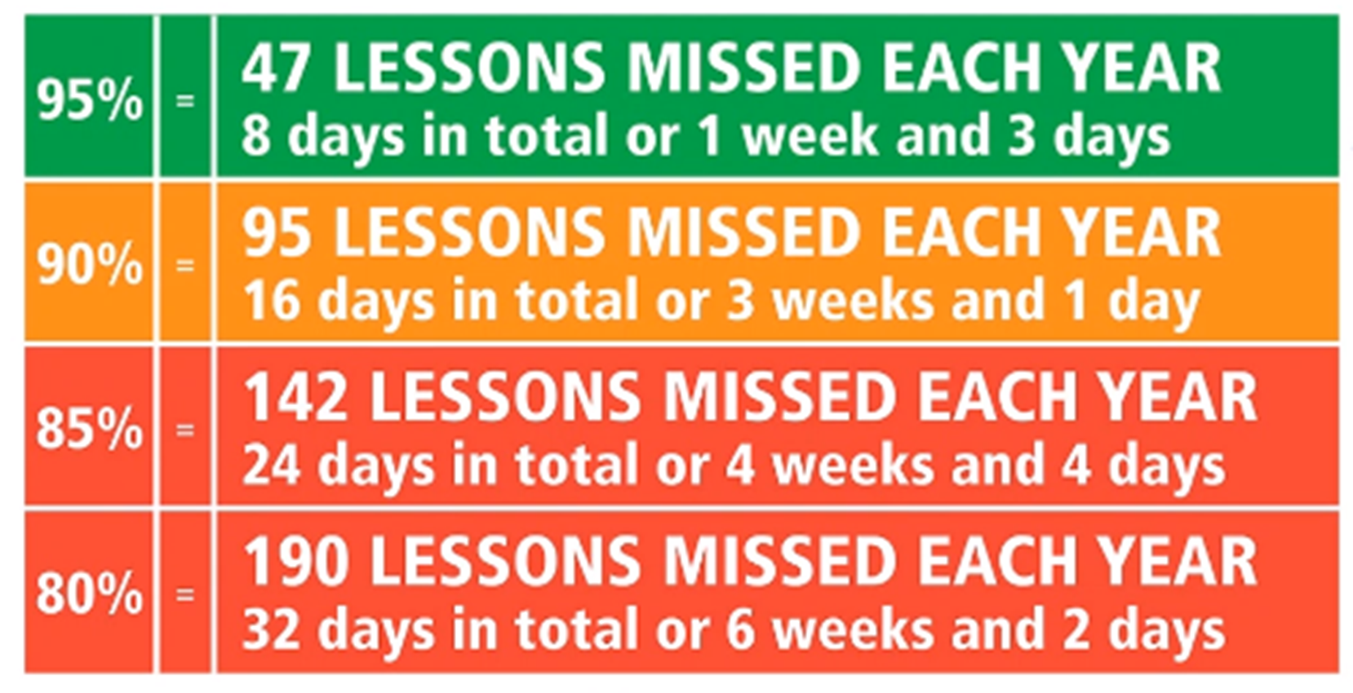
Every Day Attendance
Children arrive at school at 8:40, ready to come
into school at 8:45 when the gates will be closed.
Teachers take the register at 8:45.
Punctual arrival is important, as teaching starts promptly - aim for 100% attendance!
Did you know…?

Slide 4
Every Day Attendance
Please inform the School Office if your child is unwell on the morning of the illness (email or phone message).
Medication: avoid dosage in school if possible. Most 3x day dosages can be taken straight after school. Any prescribed or OTC medication brought in must be in the original packaging, in a named bag and handed in to the Office - there is a form to complete.
48 hours is needed before returning to school following diarrhoea and/or vomiting.
Term time absence, other than illness, is only authorised by the Head Teacher in exceptional circumstances - see Attendance Policy on the school website (currently being updated).

Slide 5
Asthma & Allergies
Please do not send in nuts or nut products (including Nutella type spreads) as part of snacks or packed lunches - we have a number of children and staff with life-threatening allergies.
Inhalers & spacers should be named and in a bag (for hygiene reasons). They are kept in a central place in class. An asthma card must be completed.
Epi-pens should be in date, in a named container and handed to the School Office with the protocol.
It is the parent/carer’s responsibility to ensure inhalers and auto-injectors are in date
and in school.
See our Medicines in School policy on the school website

Slide 6

Year 6 Essentials: Every Day
Water bottles should be brought into school
daily. Children can refill them in school as
needed and must take them home to clean
at the end of the day - water only please,
no squash, juice or fizzy drinks.
Clothing suitable for the weather and activities:
coat (hats & gloves in winter) and sensible shoes for outdoor playtimes (especially for Forest School).
In your bag: Reading book & Reading Record DAILY!

Slide 7
Year 6 Essentials: Every Day
Please do not bring in:
Show and tell items unless requested as part of a project or home learning task.
Pencil cases - all stationery is provided.
Toys, including collector cards.
Jewellery (small studs only for pierced ears).
No sugary snacks, fizzy drinks or sweets - healthier snacks for break time please.

Slide 8
Year 6 PE: Tuesdays and Thursdays
On a Tuesday, children will need to bring in their PE kit so that they can change in to it for the afternoon PE lesson. On a Thursday, they can come in wearing their PE kit for the morning PE lesson and will need to bring in a change of clothes to change into afterwards.
No jewellery, please
White T-shirt
Navy shorts and joggers and sweatshirt
Trainers or plimsolls
Please ensure all items are named
If your child does not have an appropriate PE kit or change of clothes in school on the relevant day, they will be given a letter to be signed and returned to school.

Slide 9

KS2 Year 6: Being Prepared for PE
Long hair must be tied back, so come prepared
with a hair band in kits.
Jewellery should not be worn in school.
Stud earrings will either need to be taken out or taped up for PE lessons. It is the children’s responsibility to organise this. School does not provide micropore tape and cannot support with putting the tape on.
Notes:
KS2 page – KS1 delete

Slide 10

Year 6 General
Letters and notices:
Most information will be via ParentMail.
Please sign up if you have not already done so.
Check the weekly newsletter for key information and the class page on the website for general year group information.
Birthdays:
Please do not send in sweets: if you want to send in something to share and celebrate, please consider something useful/enjoyable such as a small game or book for the class.
There is absolutely no requirement for this!

Slide 11
SATs: Standard Assessment Tests
SATS Week: Monday 12th May - Thursday 15th May 2024.
Your child will sit the following tests:
Monday 12th:
  Spelling (around 20 minutes)
  Punctuation & Grammar test. (45 minutes)
Tuesday 13th
  Reading paper (60 minutes)
Wednesday 14th:
  Maths Reasoning Paper 1 (40 minutes)
  Arithmetic (30 minutes)
Thursday 15th:
  Maths Reasoning Paper 2 (40 Minutes)
Writing is assessed by teachers and moderated by the county. The procedure is different from other year groups in that children must meet all criteria in order to meet the expected standard.

Slide 12
Year 6 Residential
The Year 6 Residential takes place in May (often the week following the SATs tests but final dates will be confirmed soon).
This year we will be visiting Kingswood Activity Centre in West Runton.
“Perched high on cliff tops overlooking the North Norfolk coastline, this former girls’ boarding school is set in beautiful pine-fringed grounds. The main building and activities are all fairly close together within three minutes’ walk, giving this centre a friendly campus feel, however this 30 acre site is packed with indoor and outdoor activity facilities.”
There will be an initial interest form coming soon to allow us to ascertain final costings before we take deposits in October.
There will also be more information about financial assistance on a letter to follow.

Slide 13
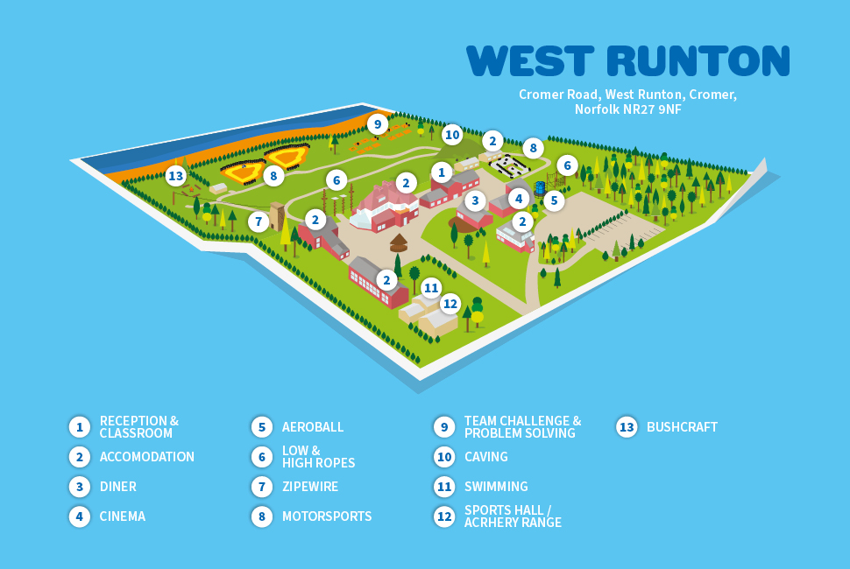

Slide 14
Safer Cycling
‘Bikeability’ will take place at the end of February.
You must sign a consent form acknowledging the following:
The instructors may refuse to train my child if they deem his/her bike to be unroadworthy (instructors may make minor adjustments but won’t fix faults or replace parts)
It remains my responsibility to make sure that my child does not ride an unroadworthy bike and if I am in doubt as to whether a bike is roadworthy I should seek the advice of a professional mechanic
The instructors may at any time refuse to continue to train my child if his/her behaviour or cycling ability level is deemed to be unsuitable.(As a general rule of thumb, can they lift a hand off their handlebars to indicate and continue cycling safely?)
I agree for my child to wear a helmet which I will provide.

Slide 15
Year 6 Essentials: Helping at Home
At Morley Memorial Primary School we see home learning as an opportunity for children to practise skills, develop independence, consolidate and reinforce learning and as an avenue for children to pursue interests and be creative.
Home learning also provides unique opportunities for family learning and collaboration.
Please support your child to complete tasks in their own way in order that they develop our positive learning dispositions at home and at school:
Motivation Curiosity Courage
Collaboration Resilience Reflection

Slide 16

Year 6 Essentials: Helping at Home
We believe every child has the right to a childhood, opportunities to play and explore and time to develop their talents and interests. We therefore try to keep home learning to a level which allows an appropriate balance.
We will assign home learning where there will be benefits to children’s learning rather than to fulfill an expectation of a particular number of hours a week. This approach we believe promotes effective home learning with activities which are meaningful and increase children’s engagement and achievement.
Having said this, frequent (daily) reading and practice of number facts is crucial if children are to make good progress and develop key, basic skills.

Slide 17
Year 6 Essentials: Home Learning
In Year 6, our Home Learning tasks will almost always include:
Regular (daily) reading – remember the Reading Record book!
A Maths and English task on SATsCompanion.
Spelling of keywords for our year group
Maths fluency practice
Notes:
KS1 page – KS2 delete

Slide 18
Year 6 Essentials: Home Learning
Home learning in KS2 often also includes tasks such as:
Independent research about a topic or aspect of
in-school learning
Creating artefacts, models or artwork related to topics being studied
Creating presentations for group work
Learning new vocabulary for the topic, or related to Year Group word lists
Consolidation and revision activities based on what has been learnt in class.
Notes:
KS2 page - KS1 delete

Slide 19

Google Classroom & E-Safety
Home Learning information and tasks are
shared via Google Classroom.
In Year 6, homework will be shared on Fridays.
Google Classroom provides great opportunities for collaborative learning and the sharing of online information.
However, online activity presents its own challenges and issues. Please ensure children are supervised appropriately while working online, and that their interactions online are respectful of others and appropriate to the task.
If you, as a parent or carer, need to contact the teacher please email the school office in the usual way.
Please see the e-safety information on our school website:
www.morley.cambs.sch.uk/e-safety-for-parents/
Notes:
KS2 page – KS1 delete

Slide 20

Thank you for all your support!
Home/school communication is key
to children’s success: when children
know that all adults around them
are working together with the same
aims then they feel secure and are more
likely to succeed.
Are there any general questions?
For individual queries please contact the office
to make an appointment.

Slide 21
Finally - Links on the website:
Link to this presentation (by the end of the week)
Maths, Reading and Writing Age Related Expectations (Target Tracker)
Year 6 spelling list
Maths fluency practice information
Penpals cursive handwriting example
Long term curriculum plan & Curriculum Descriptors
THANK YOU!
If anyone is available to support our trip to the Zoology Museum on Tuesday 17th (am Lilac and pm Violet), please let us know.

