Slide 1
Year 1 Phonic knowledge and the
Phonics Screening Check
Information session for parents
17th May 2018
Morley Memorial Primary School

Slide 2
Talk Focus:
Phonic terminology
Which phonemes / graphemes have been taught by the end of Year 1
What is the phonics screening check?
What will the children be expected to do?
How will the data be used?
How can you help?
Correct pronunciation / articulation of phonemes
Notes:
Correct terminology should be introduced from YR onwards.
Children do not have a problem using phonic terminology (in fact they are often very proud of their ability to do so).
However, you are likely to meet resistance from some teachers who consider it ‘over the top’ and unnecessary to teach this vocabulary to children. It is sometimes worth using a numeracy analogy with these staff: we wouldn’t dream of teaching 3-D shapes to children and using the word ‘ball’ instead of ‘sphere’ or ‘box’ instead of cube/cuboid.
The principle with phonic vocabulary is exactly the same – it’s just that we haven’t been used to using these words with children until relatively recently.
Using phonic terminology from the outset ensures accuracy and promotes shared understanding between practitioners and practitioners and children.

Slide 3
Phonic terminology: some definitions
A phoneme is the smallest unit of sound in a word (your mouth stays in one position to make this sound)
A grapheme is the letter, or letters, representing a phoneme
t ai igh
Notes:
Correct terminology should be introduced from YR onwards.
Children do not have a problem using phonic terminology (in fact they are often very proud of their ability to do so).
However, you are likely to meet resistance from some teachers who consider it ‘over the top’ and unnecessary to teach this vocabulary to children. It is sometimes worth using a numeracy analogy with these staff: we wouldn’t dream of teaching 3-D shapes to children and using the word ‘ball’ instead of ‘sphere’ or ‘box’ instead of cube/cuboid.
The principle with phonic vocabulary is exactly the same – it’s just that we haven’t been used to using these words with children until relatively recently.
Using phonic terminology from the outset ensures accuracy and promotes shared understanding between practitioners and practitioners and children.

Slide 4
Phonic terminology: some definitions
A digraph is 2 letters making one phoneme.
cow
A vowel digraph is 2 vowel letters making one phoneme.
moon
A consonant digraph is 2 consonants making one phoneme.
chip
Notes:
Correct terminology should be introduced from YR onwards.
Children do not have a problem using phonic terminology (in fact they are often very proud of their ability to do so).
However, you are likely to meet resistance from some teachers who consider it ‘over the top’ and unnecessary to teach this vocabulary to children. It is sometimes worth using a numeracy analogy with these staff: we wouldn’t dream of teaching 3-D shapes to children and using the word ‘ball’ instead of ‘sphere’ or ‘box’ instead of cube/cuboid.
The principle with phonic vocabulary is exactly the same – it’s just that we haven’t been used to using these words with children until relatively recently.
Using phonic terminology from the outset ensures accuracy and promotes shared understanding between practitioners and practitioners and children.

Slide 5
Phonic terminology: some definitions
A split digraph is 2 vowels making one phoneme with a consonant in between.
spine - i_e
A trigraph is 3 letters making one phoneme.
night
Notes:
Correct terminology should be introduced from YR onwards.
Children do not have a problem using phonic terminology (in fact they are often very proud of their ability to do so).
However, you are likely to meet resistance from some teachers who consider it ‘over the top’ and unnecessary to teach this vocabulary to children. It is sometimes worth using a numeracy analogy with these staff: we wouldn’t dream of teaching 3-D shapes to children and using the word ‘ball’ instead of ‘sphere’ or ‘box’ instead of cube/cuboid.
The principle with phonic vocabulary is exactly the same – it’s just that we haven’t been used to using these words with children until relatively recently.
Using phonic terminology from the outset ensures accuracy and promotes shared understanding between practitioners and practitioners and children.

Slide 6
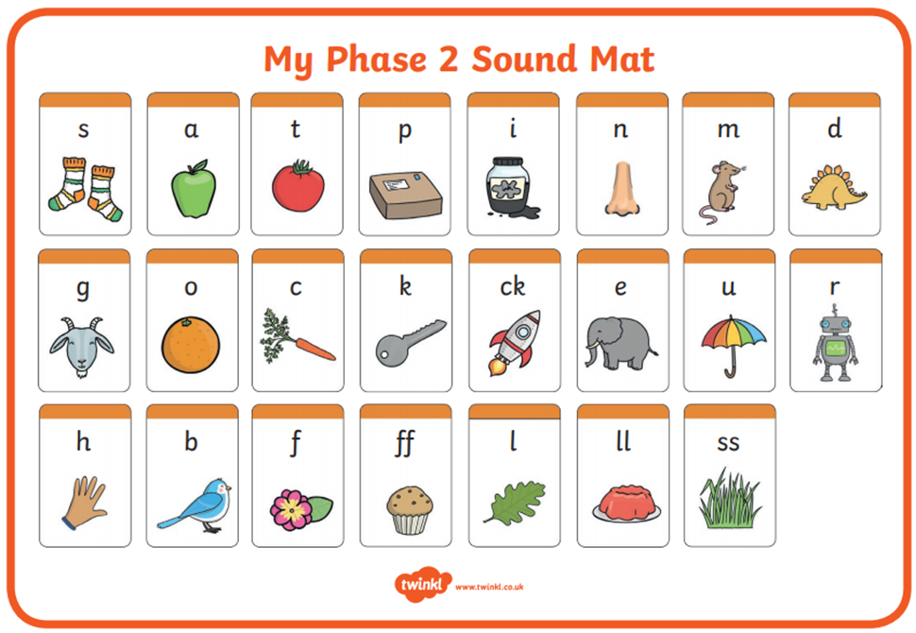
Which phonemes / graphemes have been taught by the end of Year 1:
In Reception the first phonemes taught are the alphabet represented mostly by single letter graphemes and some double letters.
Notes:
Correct terminology should be introduced from YR onwards.
Children do not have a problem using phonic terminology (in fact they are often very proud of their ability to do so).
However, you are likely to meet resistance from some teachers who consider it ‘over the top’ and unnecessary to teach this vocabulary to children. It is sometimes worth using a numeracy analogy with these staff: we wouldn’t dream of teaching 3-D shapes to children and using the word ‘ball’ instead of ‘sphere’ or ‘box’ instead of cube/cuboid.
The principle with phonic vocabulary is exactly the same – it’s just that we haven’t been used to using these words with children until relatively recently.
Using phonic terminology from the outset ensures accuracy and promotes shared understanding between practitioners and practitioners and children.

Slide 7
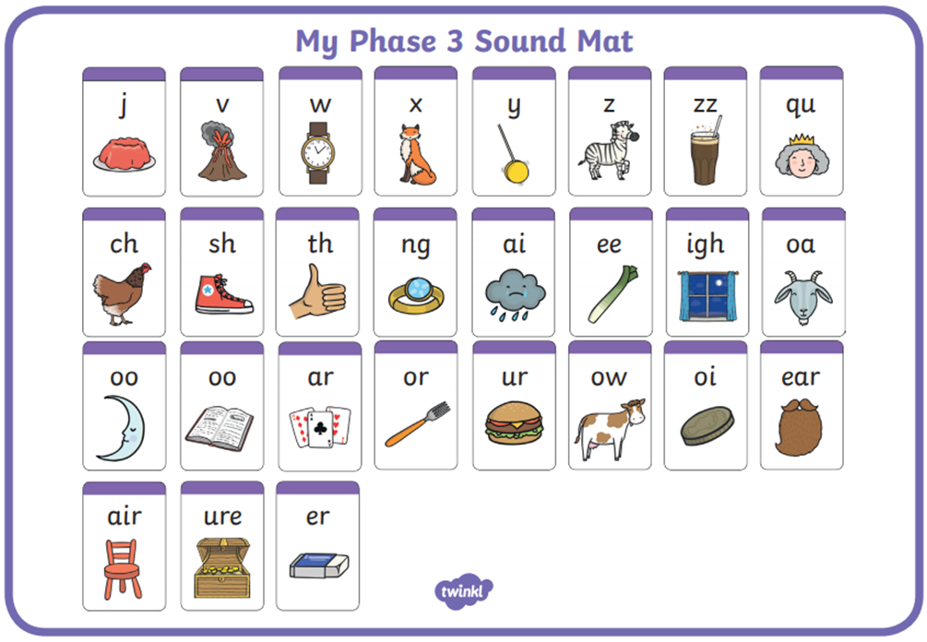
Which phonemes / graphemes have been taught by the end of Year 1:
Also in Reception more initial phonemes are taught, represented by single letter, digraph and trigraph graphemes.
Notes:
Correct terminology should be introduced from YR onwards.
Children do not have a problem using phonic terminology (in fact they are often very proud of their ability to do so).
However, you are likely to meet resistance from some teachers who consider it ‘over the top’ and unnecessary to teach this vocabulary to children. It is sometimes worth using a numeracy analogy with these staff: we wouldn’t dream of teaching 3-D shapes to children and using the word ‘ball’ instead of ‘sphere’ or ‘box’ instead of cube/cuboid.
The principle with phonic vocabulary is exactly the same – it’s just that we haven’t been used to using these words with children until relatively recently.
Using phonic terminology from the outset ensures accuracy and promotes shared understanding between practitioners and practitioners and children.

Slide 8
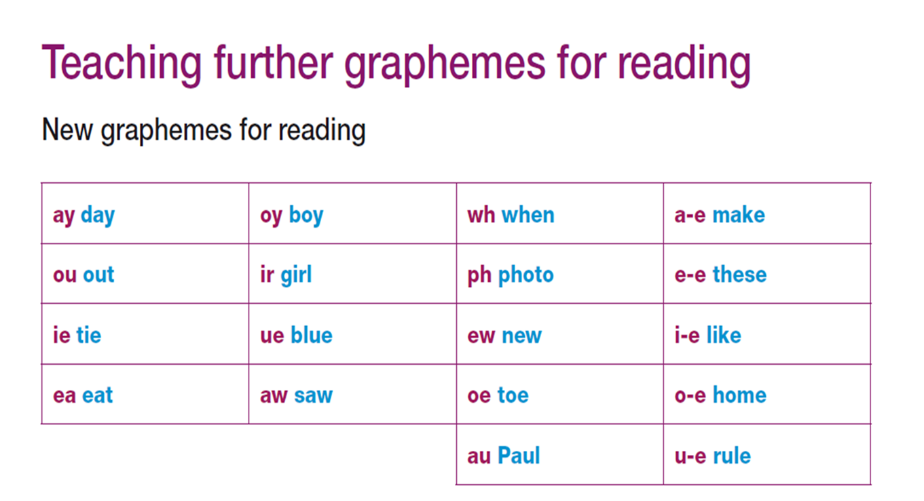
Which phonemes / graphemes have been taught by the end of Year 1:
In Year 1 children discover that some of the phonemes they learnt in Reception have more than one grapheme ai – ay, a-e
They initially learn a further grapheme for some of these, and all the split-digraphs.
Notes:
Correct terminology should be introduced from YR onwards.
Children do not have a problem using phonic terminology (in fact they are often very proud of their ability to do so).
However, you are likely to meet resistance from some teachers who consider it ‘over the top’ and unnecessary to teach this vocabulary to children. It is sometimes worth using a numeracy analogy with these staff: we wouldn’t dream of teaching 3-D shapes to children and using the word ‘ball’ instead of ‘sphere’ or ‘box’ instead of cube/cuboid.
The principle with phonic vocabulary is exactly the same – it’s just that we haven’t been used to using these words with children until relatively recently.
Using phonic terminology from the outset ensures accuracy and promotes shared understanding between practitioners and practitioners and children.

Slide 9
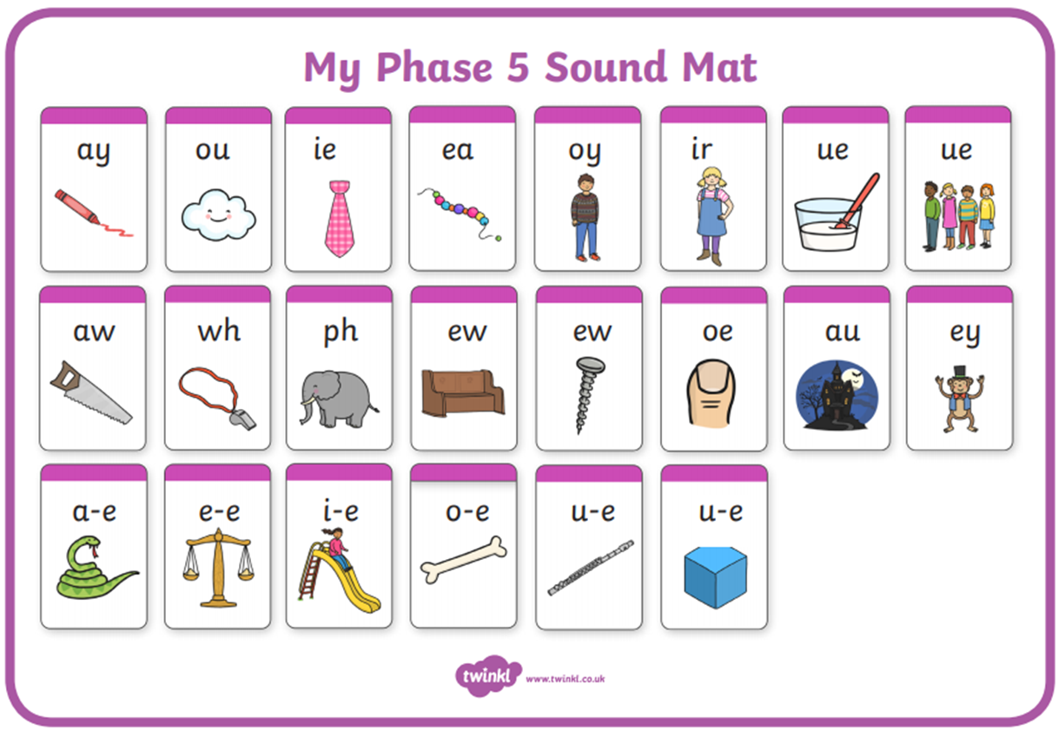
Which phonemes / graphemes have been taught by the end of Year 1:
Notes:
Correct terminology should be introduced from YR onwards.
Children do not have a problem using phonic terminology (in fact they are often very proud of their ability to do so).
However, you are likely to meet resistance from some teachers who consider it ‘over the top’ and unnecessary to teach this vocabulary to children. It is sometimes worth using a numeracy analogy with these staff: we wouldn’t dream of teaching 3-D shapes to children and using the word ‘ball’ instead of ‘sphere’ or ‘box’ instead of cube/cuboid.
The principle with phonic vocabulary is exactly the same – it’s just that we haven’t been used to using these words with children until relatively recently.
Using phonic terminology from the outset ensures accuracy and promotes shared understanding between practitioners and practitioners and children.

Slide 10
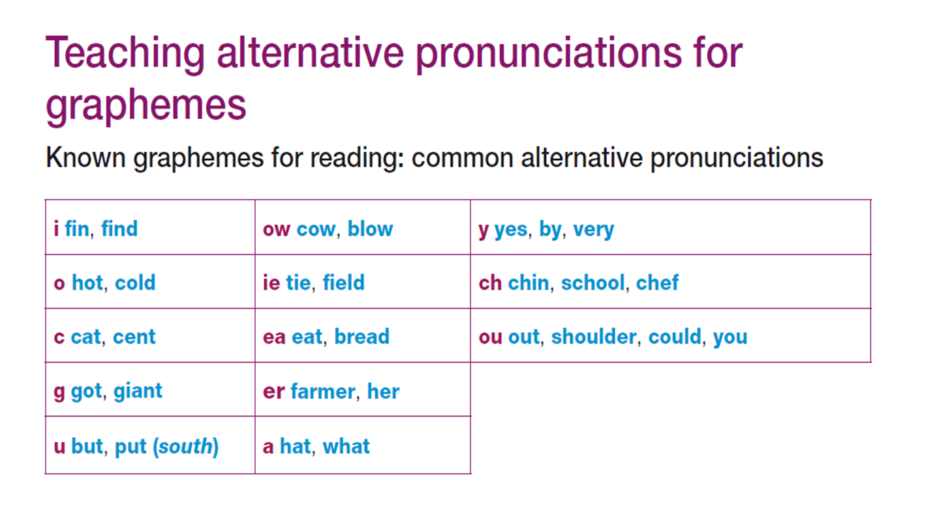
Which phonemes / graphemes have been taught by the end of Year 1:
Next in Year 1 children progress to discover that some of the graphemes that they have learnt have more than one phoneme. E.g. ea bead / head
Notes:
Correct terminology should be introduced from YR onwards.
Children do not have a problem using phonic terminology (in fact they are often very proud of their ability to do so).
However, you are likely to meet resistance from some teachers who consider it ‘over the top’ and unnecessary to teach this vocabulary to children. It is sometimes worth using a numeracy analogy with these staff: we wouldn’t dream of teaching 3-D shapes to children and using the word ‘ball’ instead of ‘sphere’ or ‘box’ instead of cube/cuboid.
The principle with phonic vocabulary is exactly the same – it’s just that we haven’t been used to using these words with children until relatively recently.
Using phonic terminology from the outset ensures accuracy and promotes shared understanding between practitioners and practitioners and children.

Slide 11
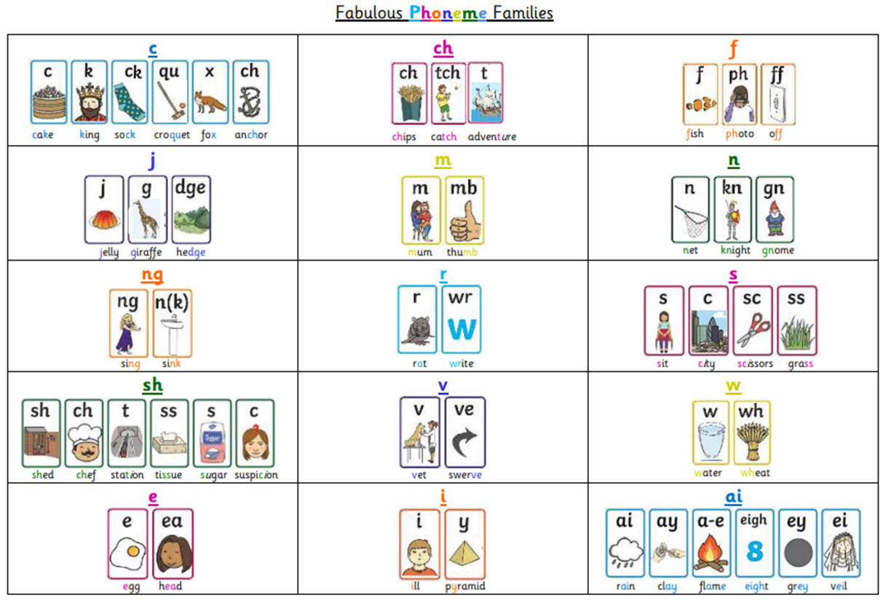
Which phonemes / graphemes have been taught by the end of Year 1:
By the end of Year 1 all the alternative graphemes for all phonemes are taught.
Notes:
Correct terminology should be introduced from YR onwards.
Children do not have a problem using phonic terminology (in fact they are often very proud of their ability to do so).
However, you are likely to meet resistance from some teachers who consider it ‘over the top’ and unnecessary to teach this vocabulary to children. It is sometimes worth using a numeracy analogy with these staff: we wouldn’t dream of teaching 3-D shapes to children and using the word ‘ball’ instead of ‘sphere’ or ‘box’ instead of cube/cuboid.
The principle with phonic vocabulary is exactly the same – it’s just that we haven’t been used to using these words with children until relatively recently.
Using phonic terminology from the outset ensures accuracy and promotes shared understanding between practitioners and practitioners and children.

Slide 12
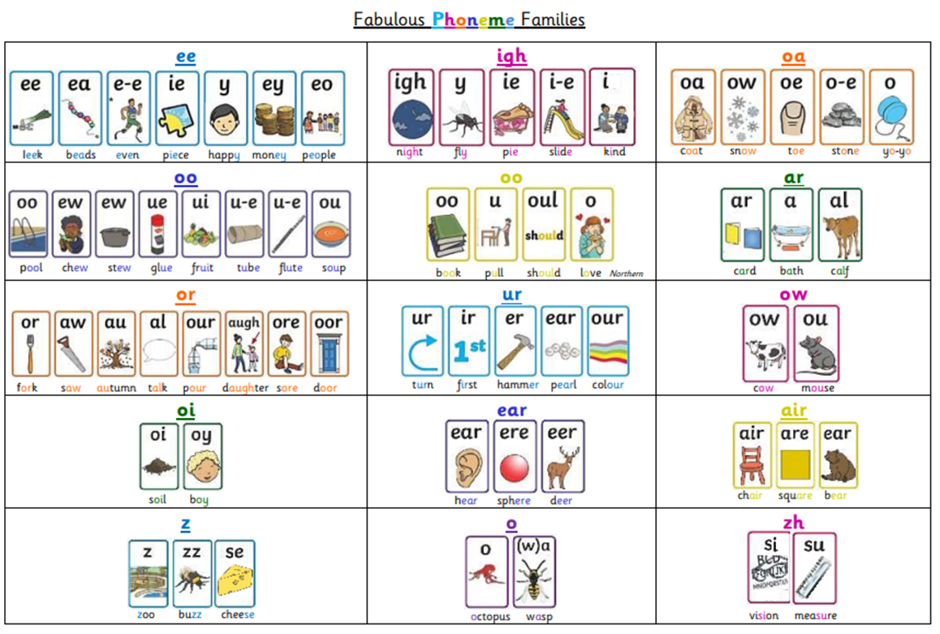
Which phonemes / graphemes have been taught by the end of Year 1:
By the end of Year 1 all the alternative graphemes for all phonemes are taught.
Notes:
Correct terminology should be introduced from YR onwards.
Children do not have a problem using phonic terminology (in fact they are often very proud of their ability to do so).
However, you are likely to meet resistance from some teachers who consider it ‘over the top’ and unnecessary to teach this vocabulary to children. It is sometimes worth using a numeracy analogy with these staff: we wouldn’t dream of teaching 3-D shapes to children and using the word ‘ball’ instead of ‘sphere’ or ‘box’ instead of cube/cuboid.
The principle with phonic vocabulary is exactly the same – it’s just that we haven’t been used to using these words with children until relatively recently.
Using phonic terminology from the outset ensures accuracy and promotes shared understanding between practitioners and practitioners and children.

Slide 13
What is the phonics screening check?
The phonics screening check is a statutory assessment for all children in Year 1.
The phonics screening check will take place during the week commencing 11 June 2018.
The focus of the Phonics Screening Check is to test children’s understanding of grapheme-phoneme correspondence and their ability to use this to decode real and pseudo (nonsense) words.
The phonics screening check comprises of a list of 40 real and pseudo words that children read one-to-one to their teacher in a quiet area of the school.
There is no time limit but the phonics screening check normally takes up to 10 minutes for each child.

Slide 14
What will the children be expected to do?
Children will be told they are doing a sounding out and blending quiz rather than a reading test.
They will be asked to read the real and nonsense words aloud.
Children can ‘sound out’ before trying to say the whole word if this helps them.
It will be pointed out that if there is a picture of an alien next to the word it isn’t a real word.

Slide 15
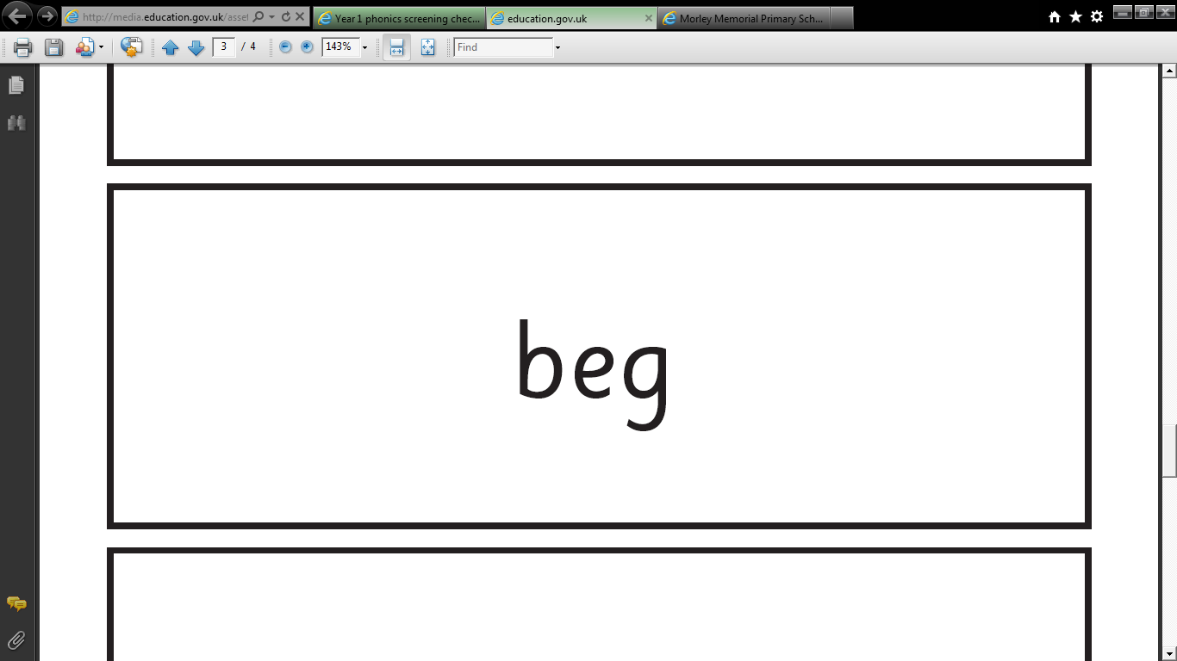
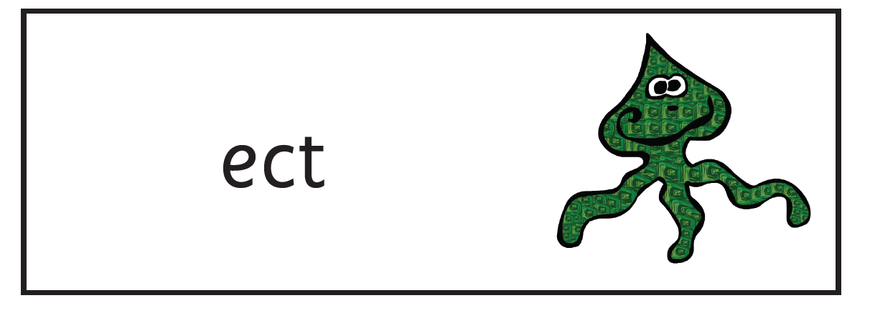
The phonics screening check will be constructed of 20 real words and 20 pseudo-words.
The pseudo words will be presented with a picture of an alien next to them.

Slide 16
What type of words will the Phonics Screening Check contain?
The check will begin with simple words and moves on to more complex words. There will be:
Simple CVC words for example the psudo word, v-a-p
Words with consonant digraphs such as ch-i-ll
Words with vowel digraphs such as w-ee-k or h-oo-k-s
Words with adjacent consonants such as s-t-ar-t or psudo words such as j-ou-n-d
Words containing split digraphs such as ph-o-n-e or s-l-i-d-e
Words with alternative spellings of phonemes such as d-ay and t-r-ai-n-s
Psudo words that can be pronounced in alternative ways for example v-oo-n
Two- syllable words such as d-e-n/t-i-s-t.

Slide 17
How will the data be used?
The data will be used in the following ways:
Individual children’s results will be sent home to parents with their annual report, so that parents are kept informed about their child’s progress.
Results will be recorded in Target Tracker where they will be available to the teaching staff to use to support children’s next steps in learning.
The results will be reported to The Local Authority for data analysis and monitoring and for use in Ofsted inspections.
National and Local Authority results will be reported to track standards over time and allow schools to benchmark the performance of their children.

Slide 18
How can you help?
Encourage your child to ‘sound out’ when reading or writing words they are unsure of.
Support your child to refer to a sound mat when reading and writing, focusing particularly on spotting more unusual sound patterns.
Ensure your child has plenty of sleep and breakfast the week beginning the 12.6.18.

Slide 19
Online Phonics Games
The following websites are recommended by the school but we are not responsible for their content. Please always supervise your child when they use the following websites:
Phonics Play - Free Parents Resources
http://www.phonicsplay.co.uk/Phase5Menu.htm
Teach your monster to read - Computer version is 100% free
https://www.teachyourmonstertoread.com/
BBC – ks1 Bitesize – literacy – Deep Sea Phonics
http://www.bbc.co.uk/bitesize/ks1/literacy/phonics/play/

Slide 20
Finally, remember, using phonics is only one strategy needed to become a fluent reader.
Please continue to read with your child each evening and encourage them to:
Re-read as they go to check it makes sense
Use pictures for clues
Try to remember the shape of words
Ask and answer questions about the book
And most importantly enjoy reading!

Slide 21

Thank you for attending the talk today!
Questions
Please complete an evaluation form before you leave.

Slide 22
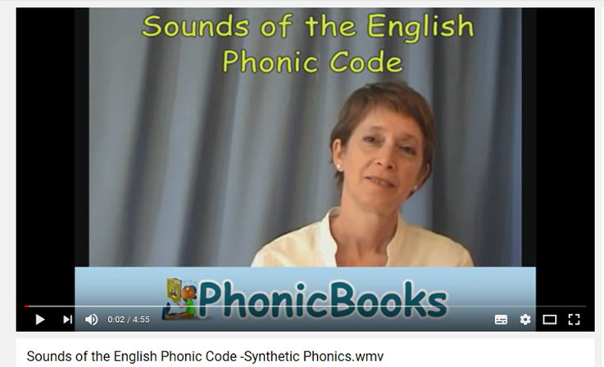
Correct pronunciation / articulation

Slide 23
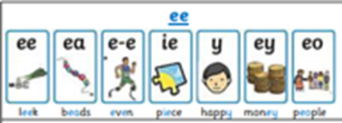
A Real Treat
Can you spot the different graphemes for ‘ee’ in this passage?
Tom was very happy. It was the weekend and he was off to the beach with his mum and dad, his puppy and baby Pete.
‘Help me pack the green bag,’ said mum. ‘We need sun cream and lots to eat.’
Tom got into his seat in the back of the car and the puppy got on his knee. Pete held his toy sheep. Off they went. Beep! Beep!
At the end of the street there was a big truck. It had lost a wheel.
‘Oh, no,’ said Tom. ‘We’ll be here for a week!’
Dad went to speak to the driver to see if he could help.
Notes:
Taken from the CDROM in PwS
Thumbs up when hear long /ee/
Pick up regional dialect. Go with what the children hear. The phonemes are generally consistent within the speech of an individual. If your own accent is so very different, when teaching a sound try to say it like the children. Be honest, discuss how you say it differently.
Highlight /ee/ words and then sort according to the grapheme on the flip chart ‘e’, ‘y’, ‘ee’, ‘ea’, ’e-e’

Slide 24
A Real Treat
Tom was very happy. It was the weekend and he was off to the beach with his mum and dad, his puppy and baby Pete.
‘Help me pack the green bag,’ said mum. ‘We need sun cream and lots to eat.’
Tom got into his seat in the back of the car and the puppy got on his knee. Pete held his toy sheep. Off they went. Beep! Beep!
At the end of the street there was a big truck. It had lost a wheel.
‘Oh, no,’ said Tom. ‘We’ll be here for a week!’
Dad went to speak to the driver to see if he could help.
Notes:
Taken from the CDROM in PwS
Thumbs up when hear long /ee/
Pick up regional dialect. (e.g. ‘puppy’ and ‘baby’ in Burnley where the ‘y’ might say /i/ or even /e/) Go with what the children hear. The phonemes are generally consistent within the speech of an individual. If your own accent is so very different, when teaching a sound try to say it like the children. Be honest, discuss how you say it differently.
Highlight /ee/ words and then sort according to the grapheme on the flip chart ‘e’, ‘y’, ‘ee’, ‘ea’, ’e-e’ (Rhyming Word Sort - PiPs)

Slide 25
Sort Words into Phoneme Frames
ee | ea | e-e | ey | y | e
see | eat | Pete | monkey | puppy | he
knee | cream |  |  | baby | we
 |  |  |  | very

