Slide 1
Little Wolf: the Rescue
With previously unseen scenes
By Burgundy Class

Slide 2
Little Wolf is busy with his Big Brothers when...

Slide 3
...he stops,

Slide 4
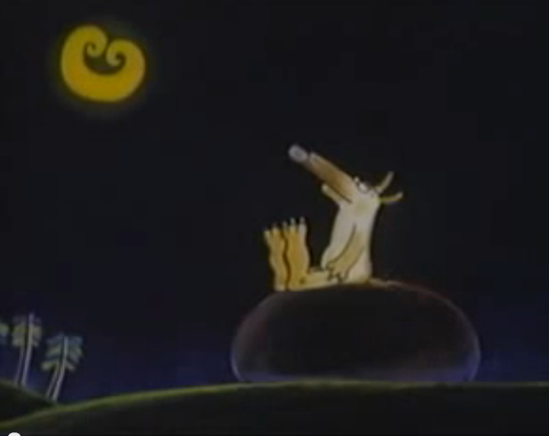
and notices the Moon!

Slide 5
The Moon comes down to play...

Slide 6
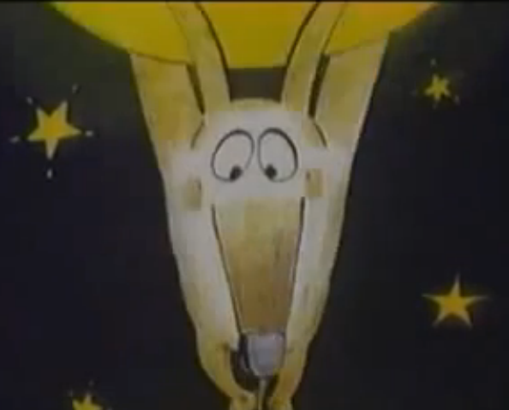
...but Little Wolf gets carried away!

Slide 7
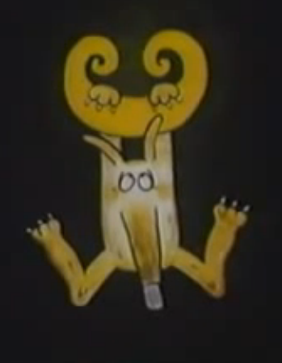
So Little Wolf is stuck!

Slide 8
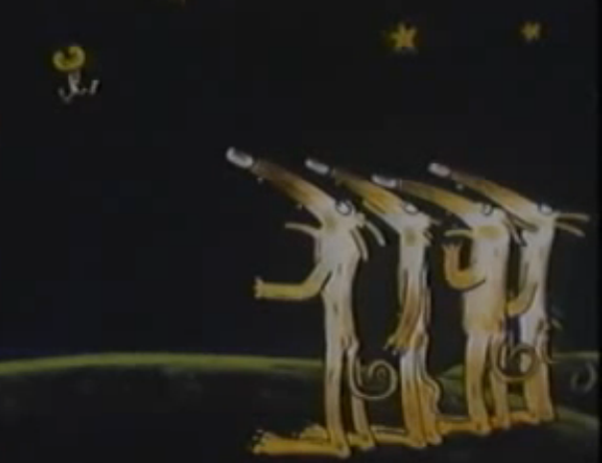
How will he get down?

Slide 9
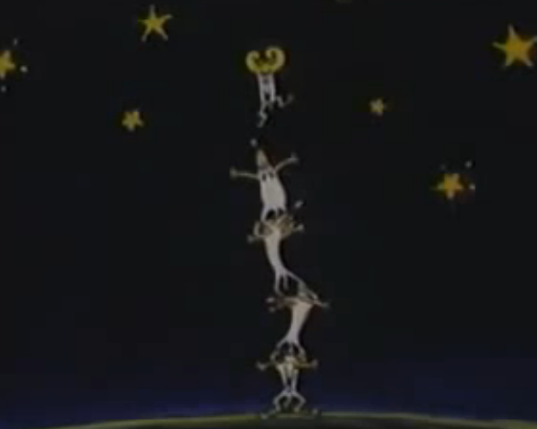
The Big Wolves try everything...

Slide 10
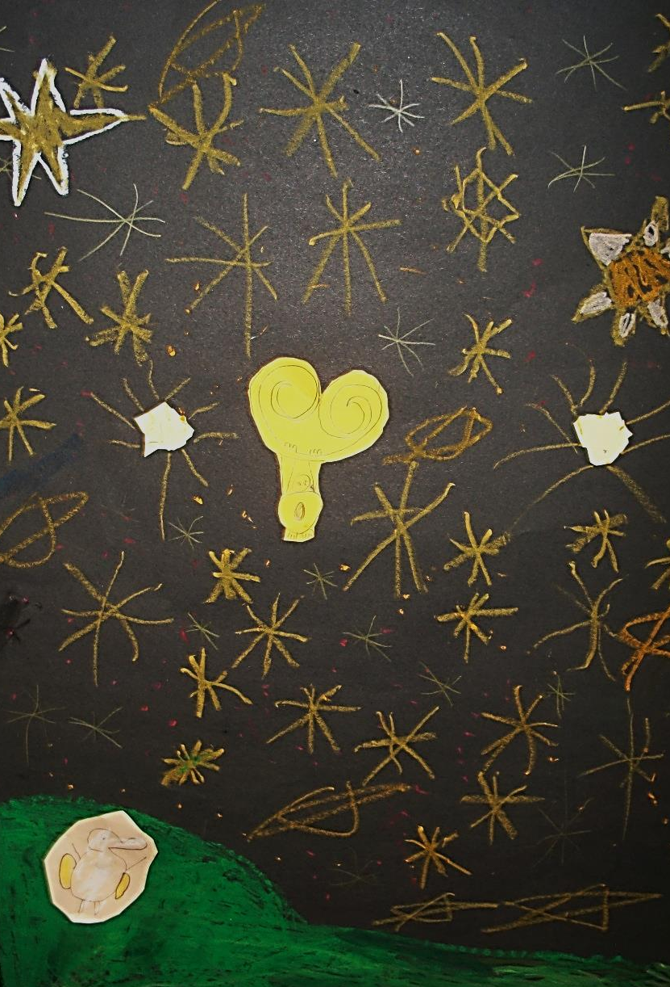
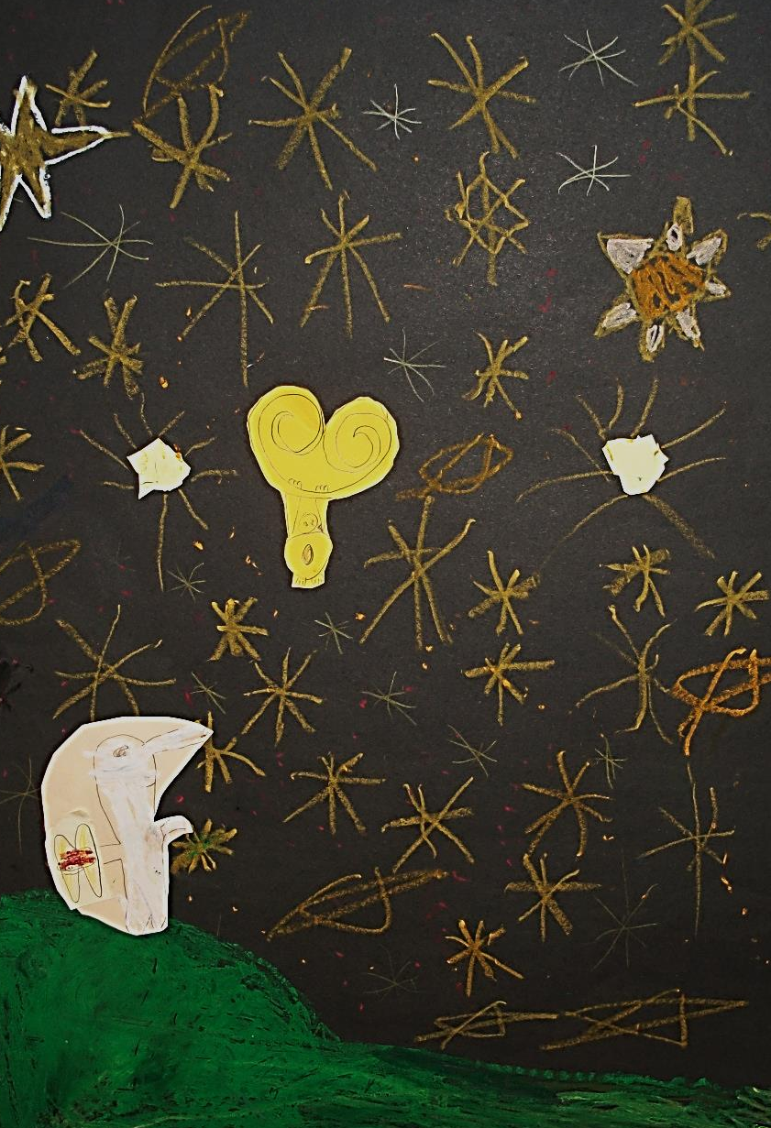
Big Wolf puts on his Jet Pack.

Slide 11
Ready for take off...

Slide 12
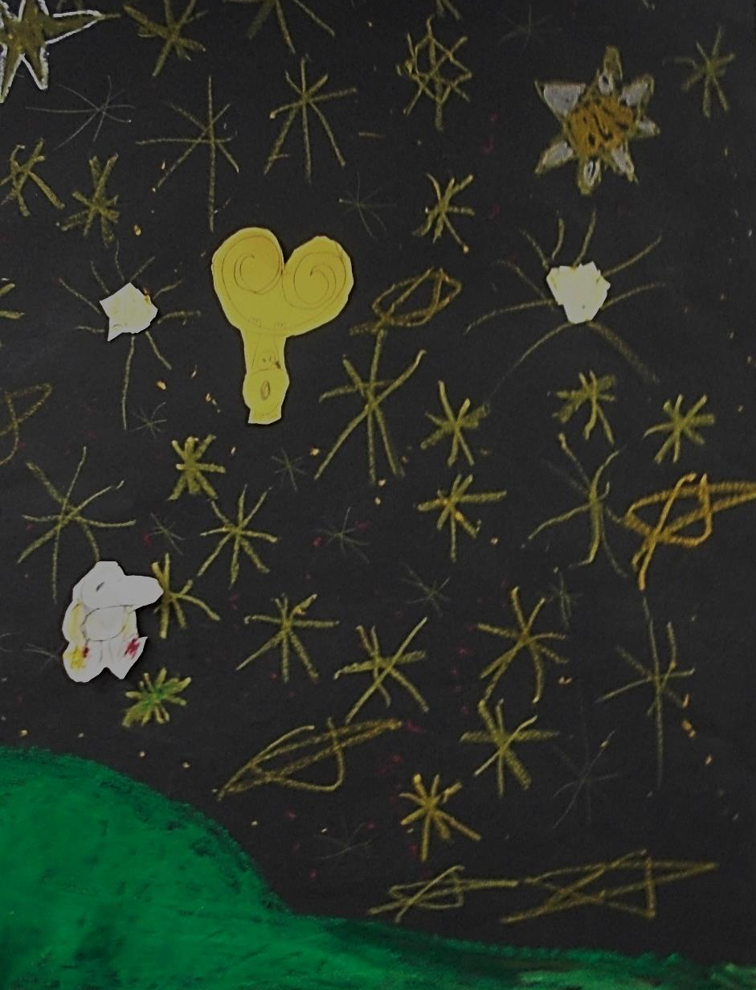
Will he get to Little Wolf?

Slide 13
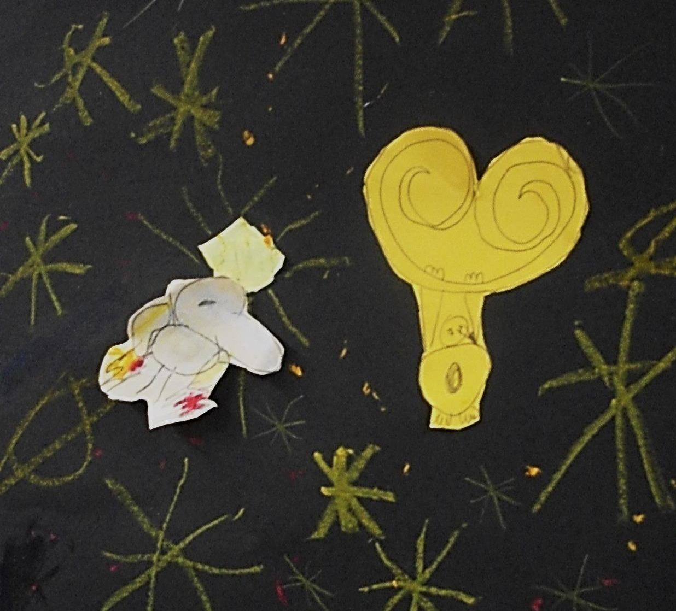
He is almost there when
he crashes into a star!

Slide 14
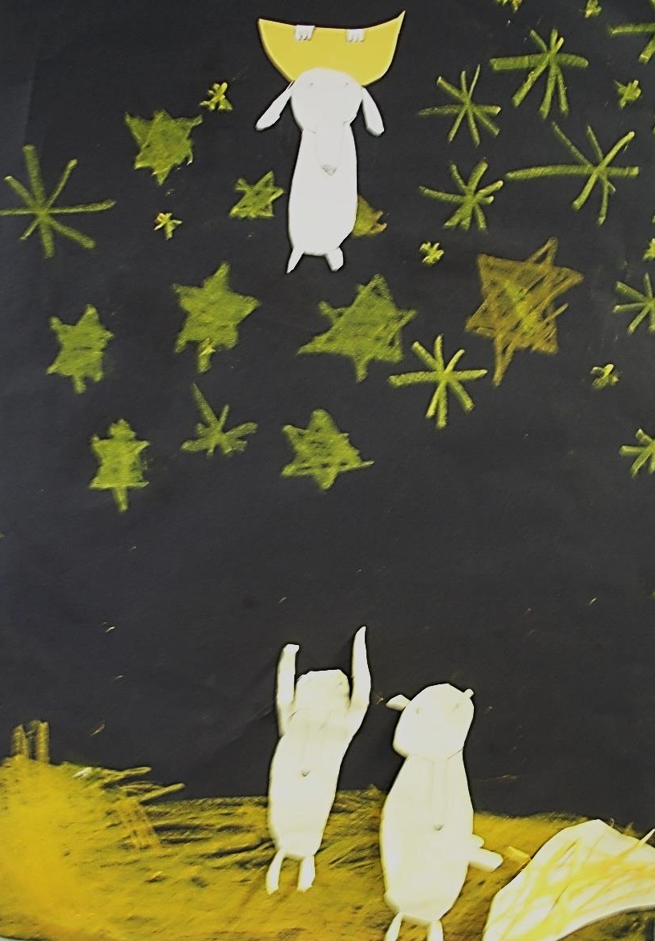
The Big Wolves look around for something to use to make a ladder.

Slide 15
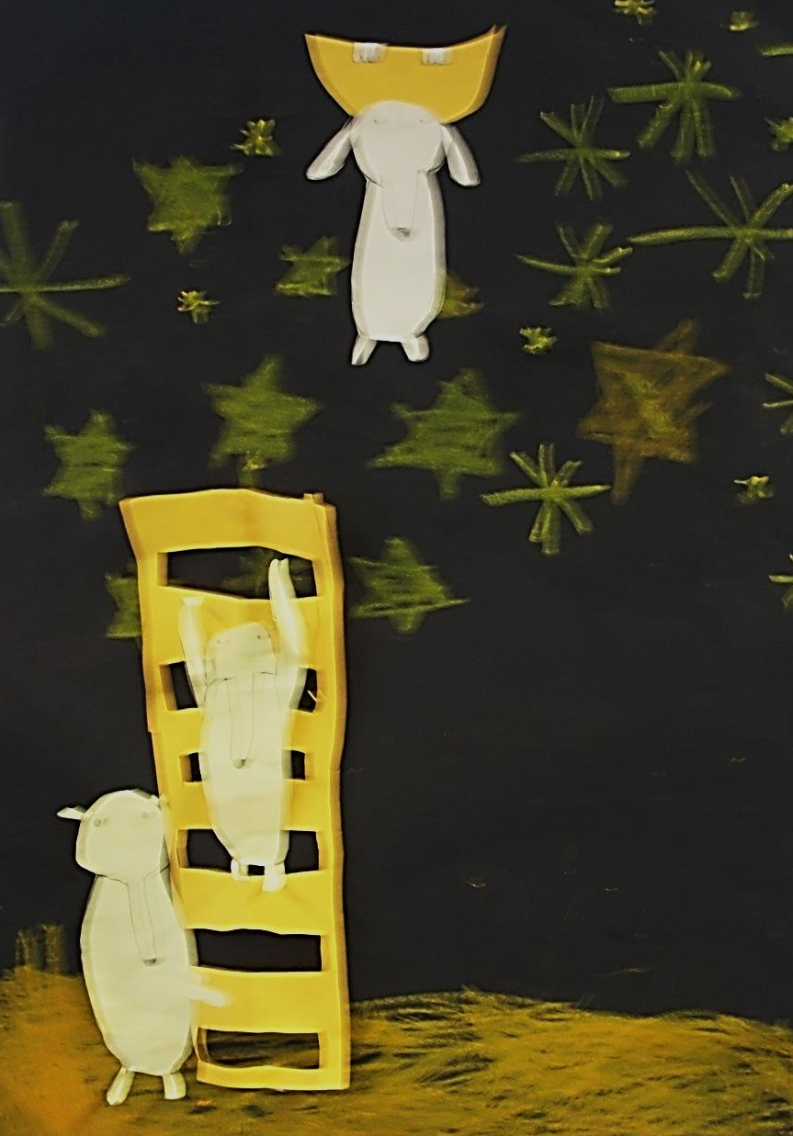
They find some straw and
up Big Wolf goes...

Slide 16
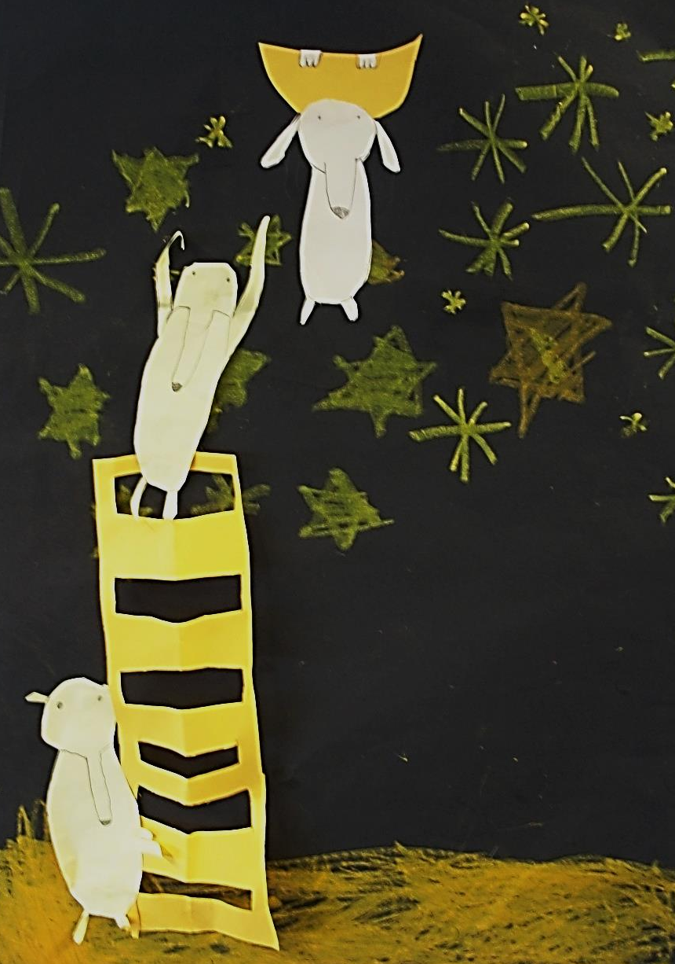
They are so close now... but the ladder is very wobbly!

Slide 17
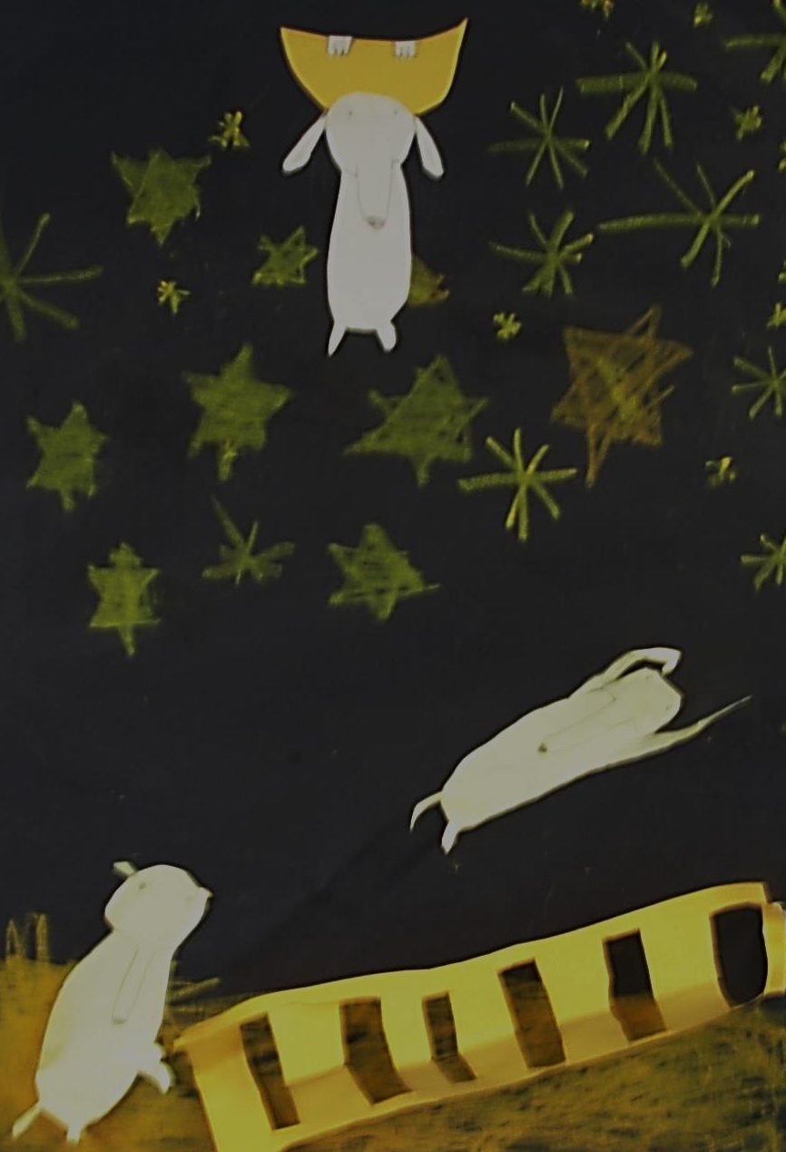
The straw is not strong enough!

Slide 18
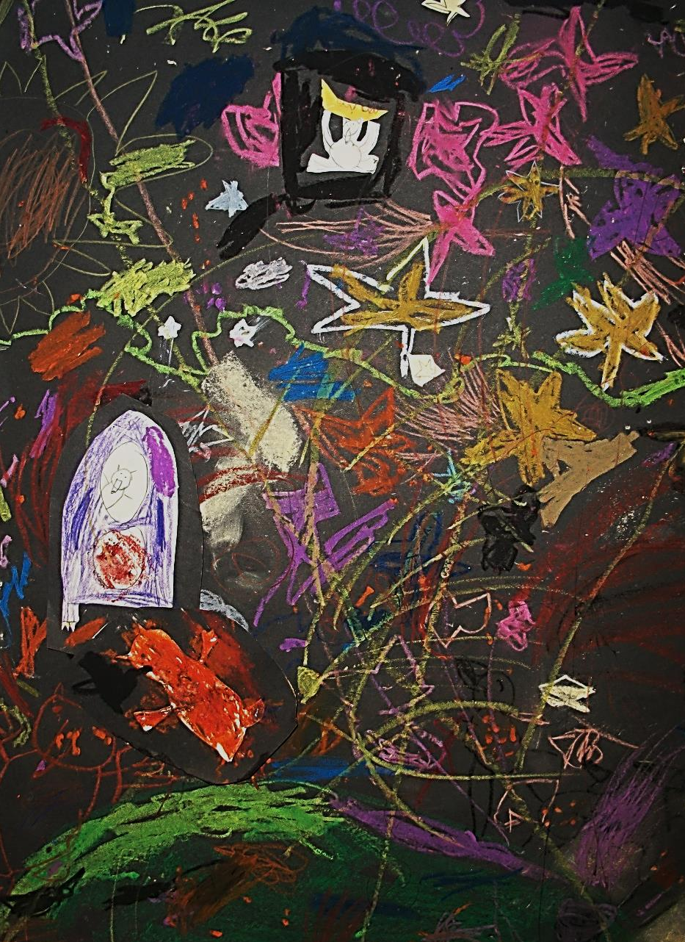
One Wolf sets off in a rocket and a second hangs on at the back.

Slide 19
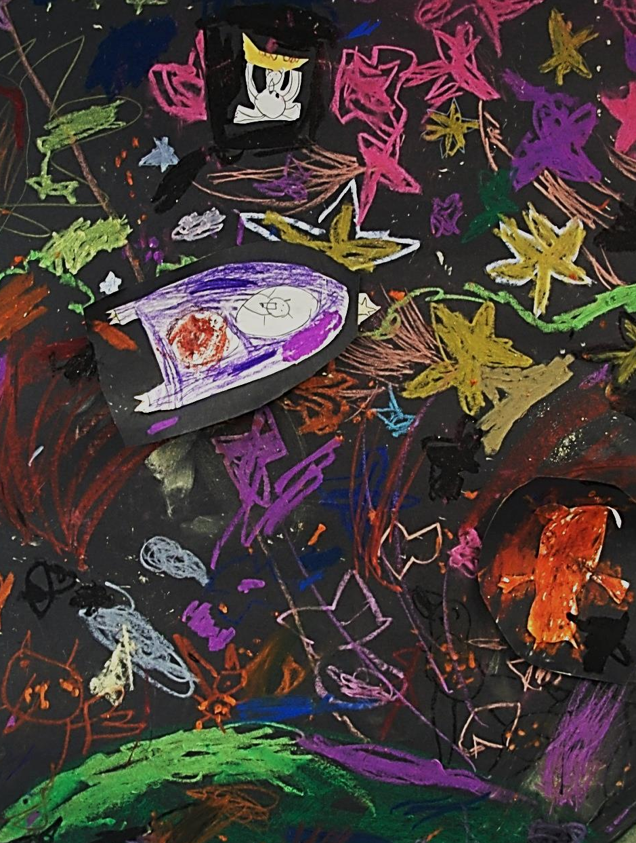
The Wolf falls and the
rocket keeps going.

Slide 20
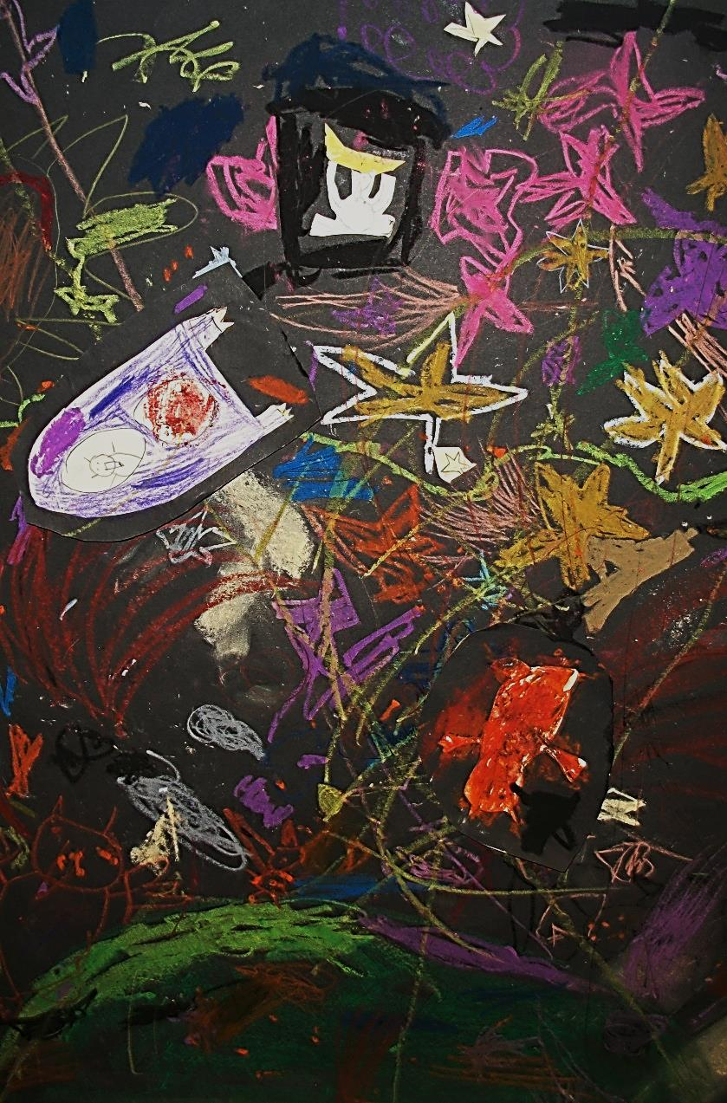
The Rocket runs out of
fuel and has to land!

Slide 21
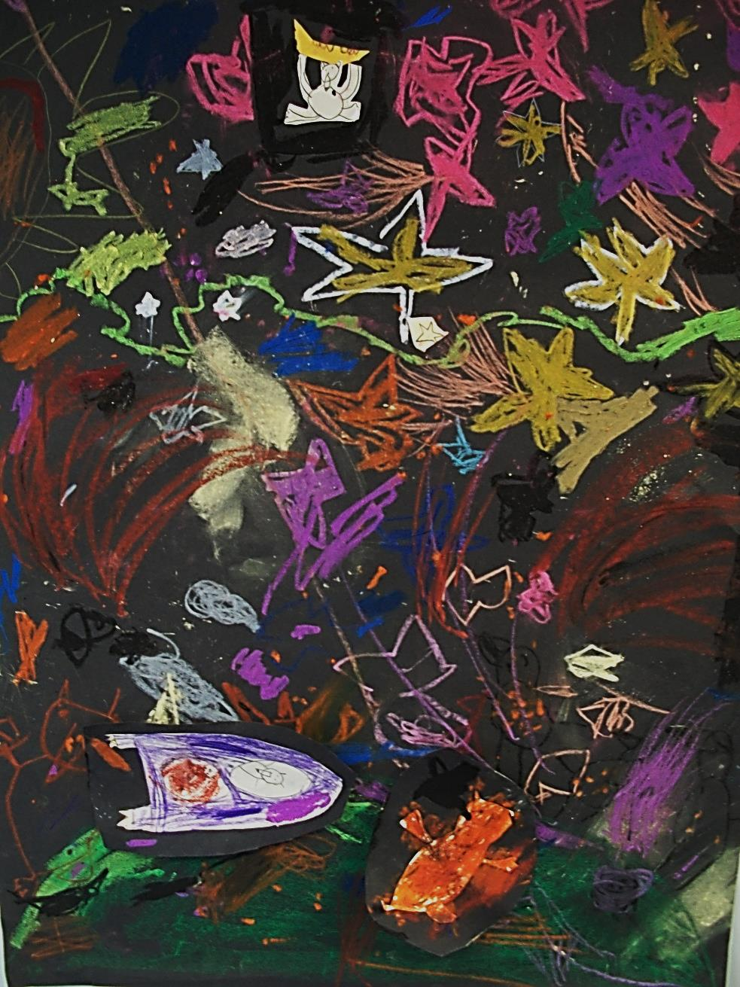
Back to earth and
Little Wolf is still stuck!

Slide 22
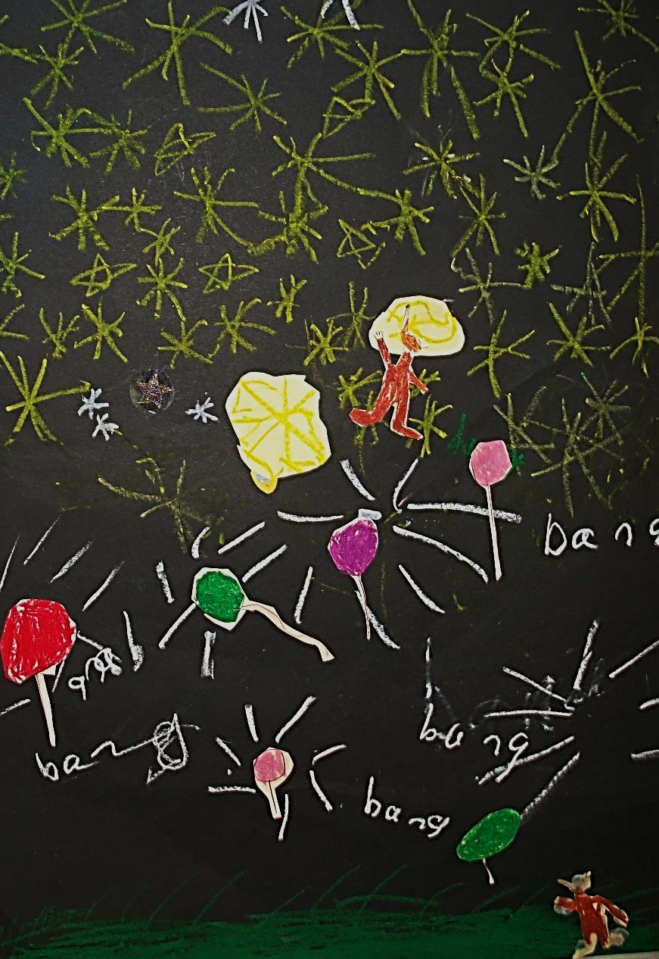
Maybe some balloons can help?

Slide 23
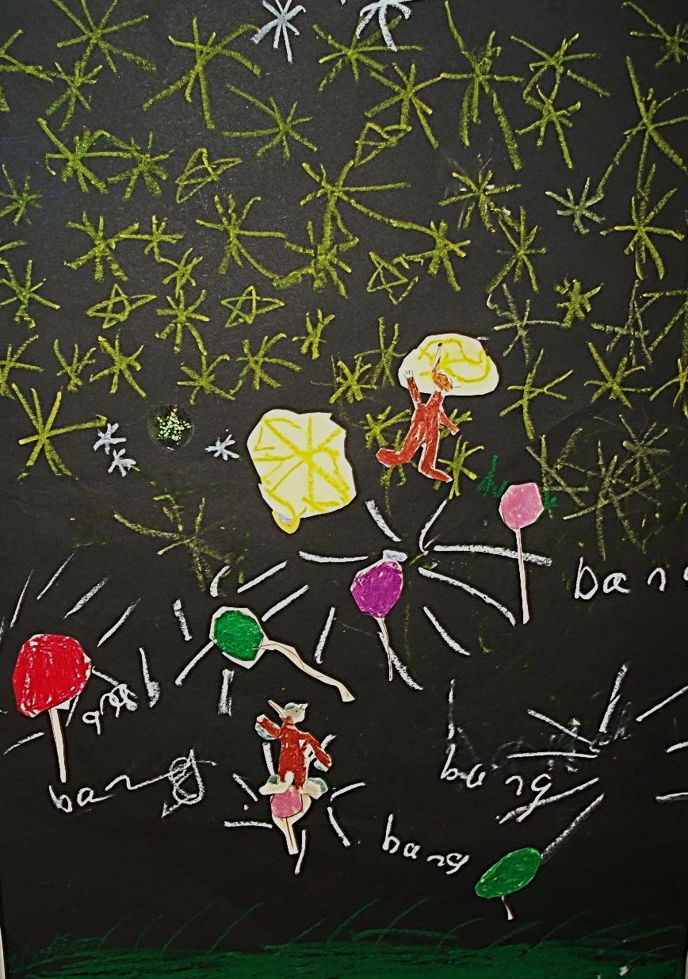
Up Big Wolf goes.

Slide 24
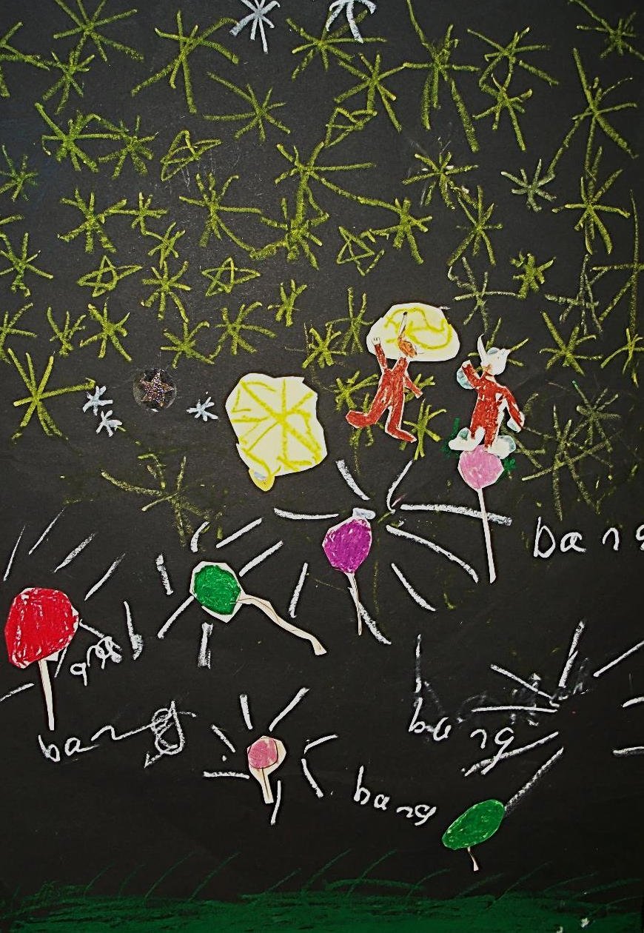
He is almost there when...

Slide 25
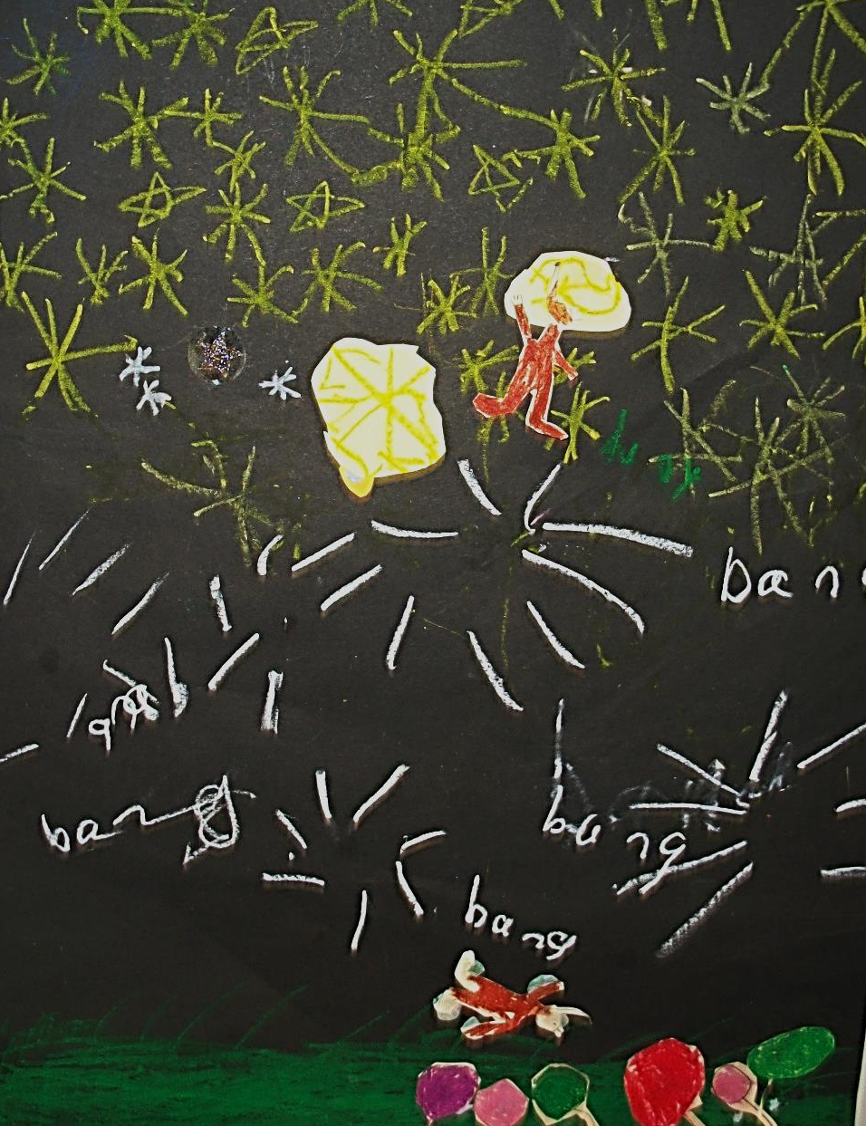
The last balloon pops
Big Wolf falls down!

Slide 26
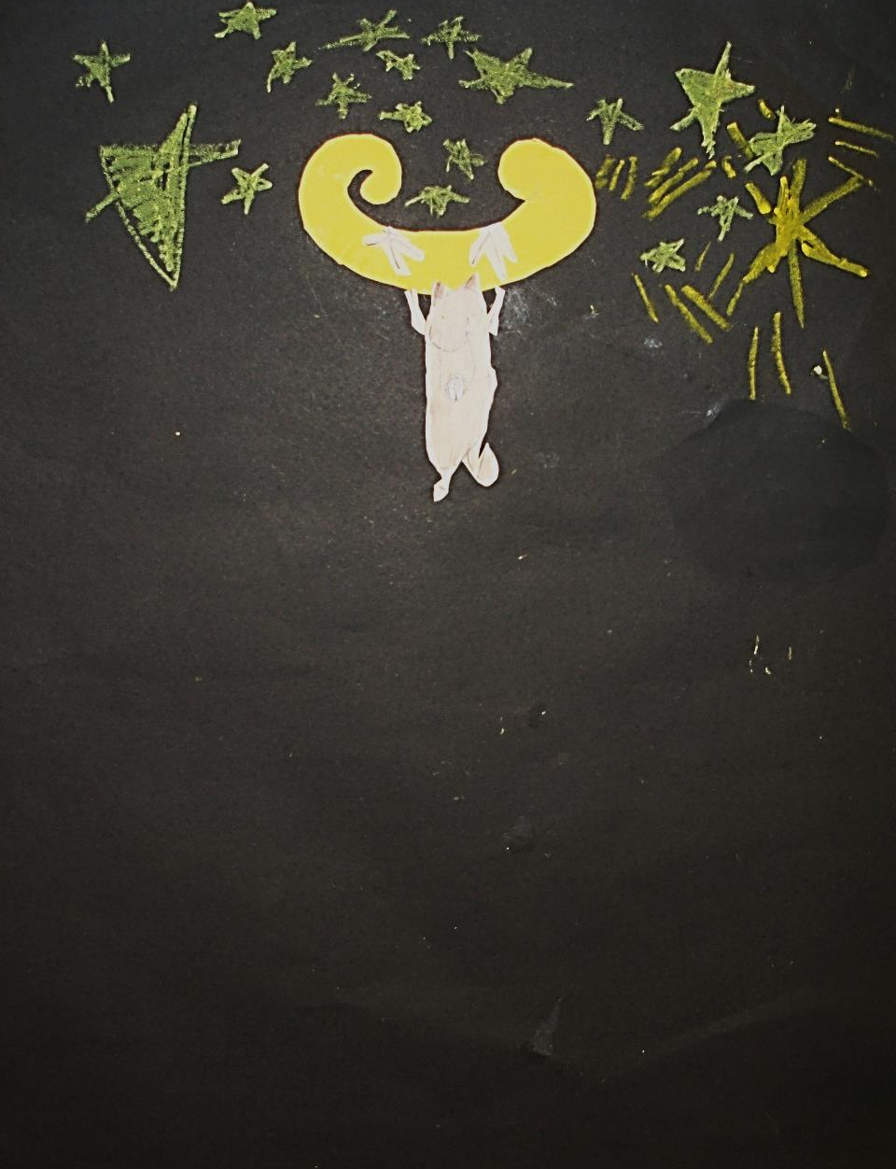
Poor Little Wolf –
will he ever get down?

Slide 27
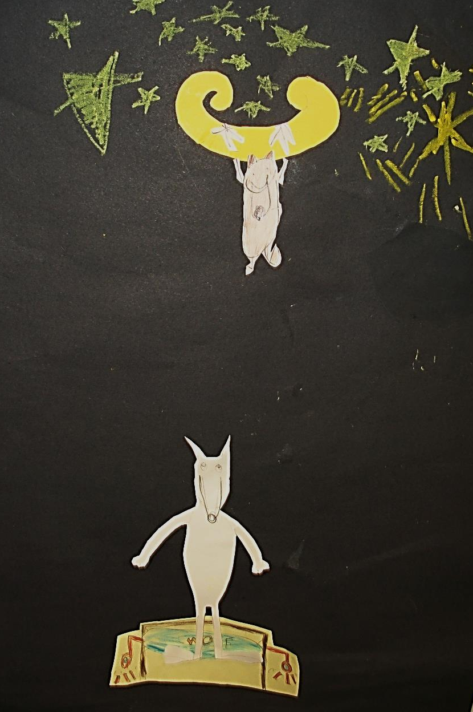
Big Wolf comes to the rescue with a trampoline powered by jet packs!

Slide 28
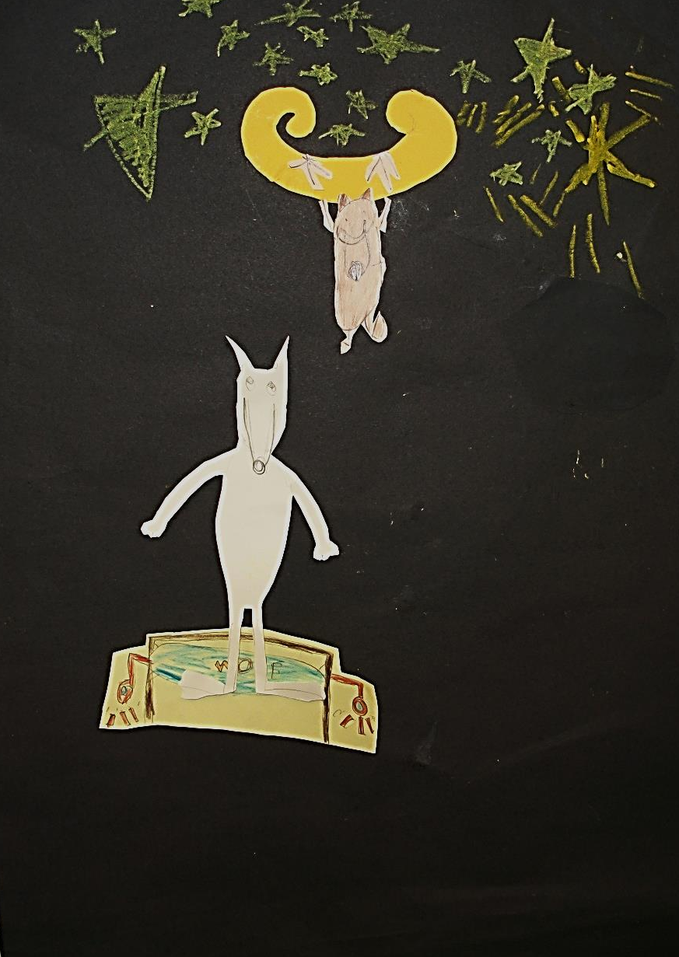
This looks like it might work!

Slide 29
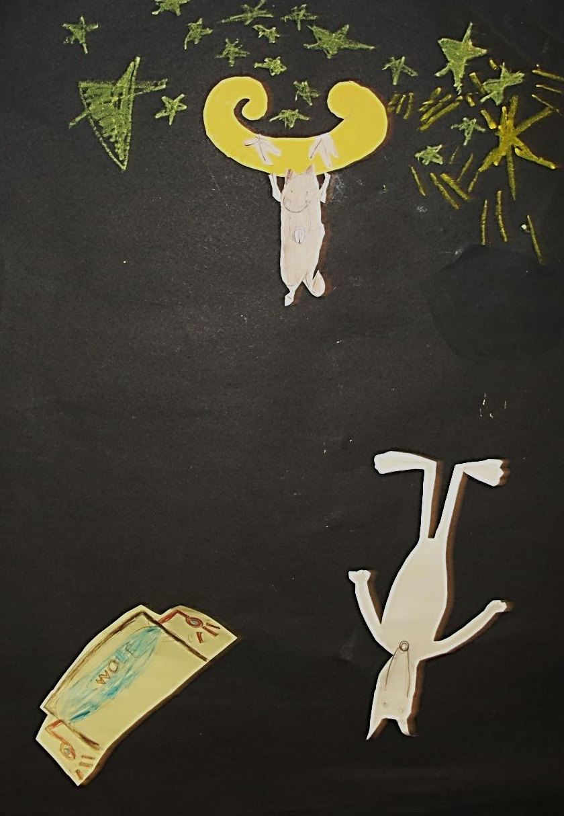
Oh No! Power Failure!

Slide 30
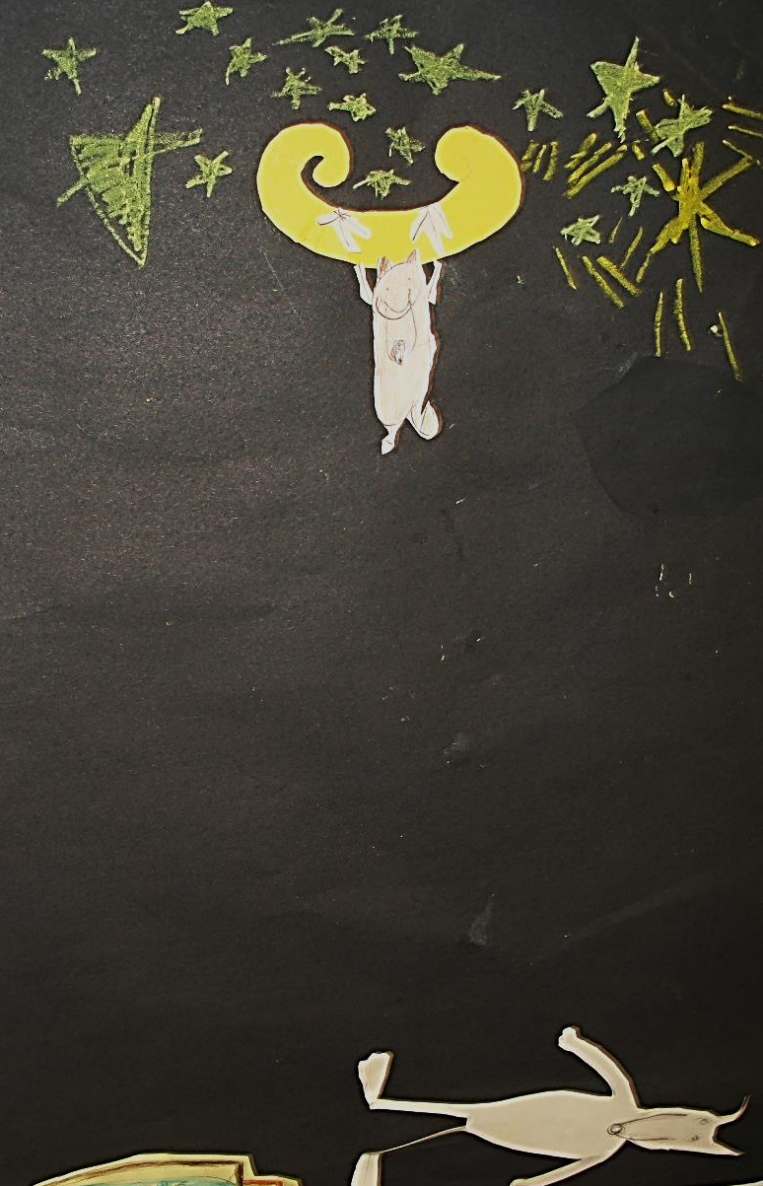
It looks like Little Wolf will have to wait!

Slide 31
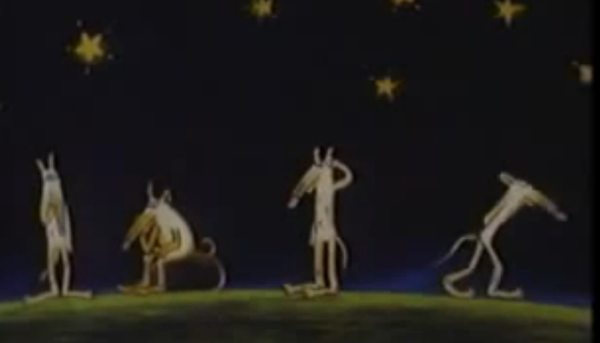
What can the wolves try next?

Slide 32
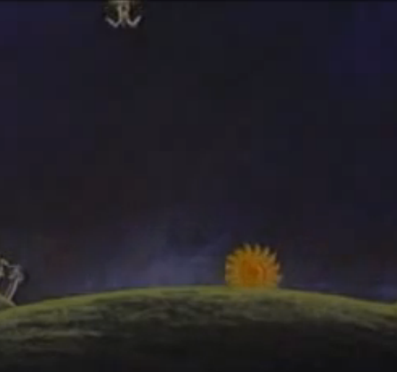
Just as they have given up, the Sun comes up, the Moon goes down and...

Slide 33
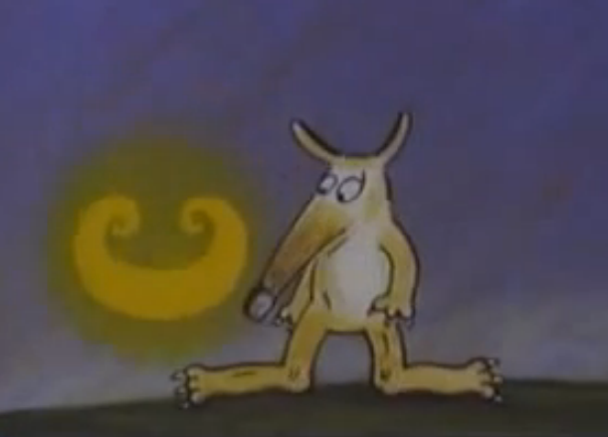
...Little Wolf is brought back
to Earth safe and sound!

Slide 34
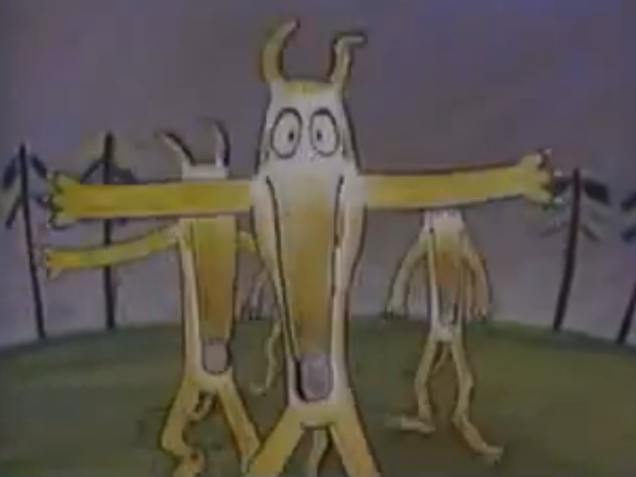
Welcome Back Little Wolf!

Slide 35
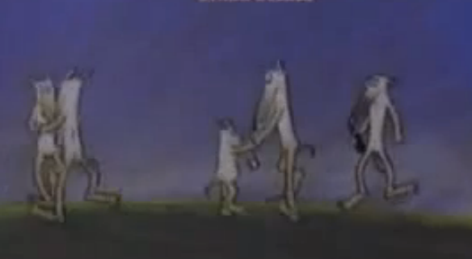
We are so glad you’re home!

Slide 36
Credits
Jet Pack: Beth, George, Jasmine
Straw Ladder: Alicia, Dulcie, Max
Rocket: Gemma, Izzy C, Gemma
Jet Pack Trampoline: Fin M, Izzy JB, Ramiro
Balloons: Julia, Katie, Taylor

