Slide 1
Little Wolf: the Rescue
With previously unseen scenes
By Burgundy Class

Slide 2
Little Wolf is busy with his Big Brothers when...

Slide 3
...he stops,

Slide 4
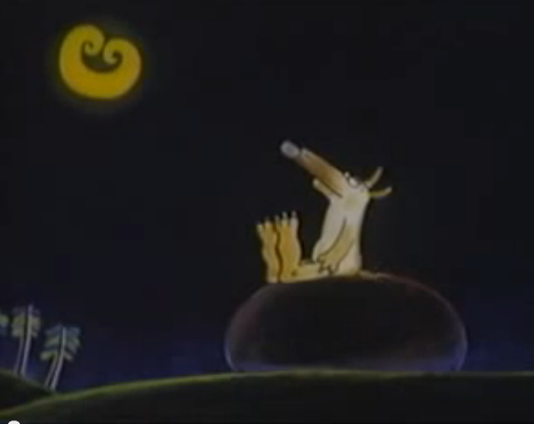
and notices the Moon!

Slide 5
The Moon comes down to play...

Slide 6
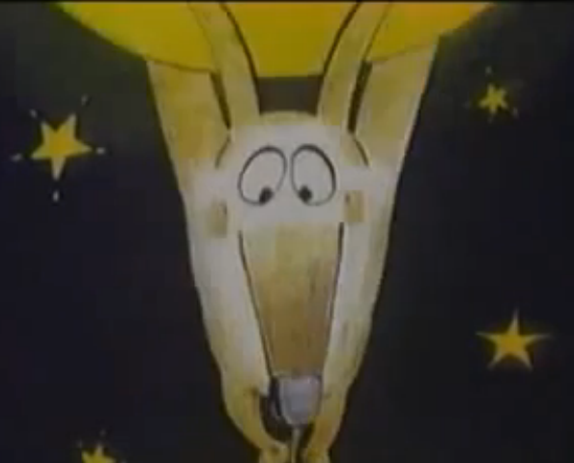
...but Little Wolf gets carried away!

Slide 7
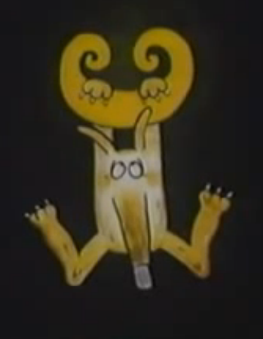
So Little Wolf is stuck!

Slide 8
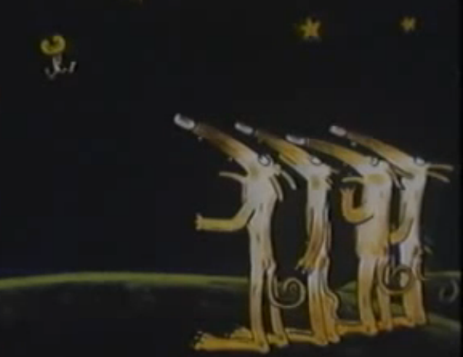
How will he get down?

Slide 9
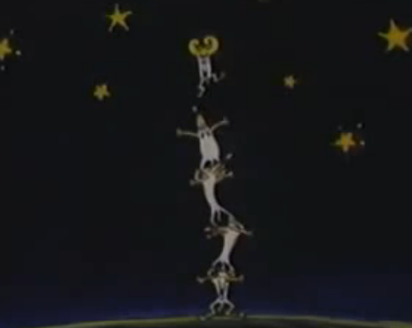
The Big Wolves try everything...

Slide 10
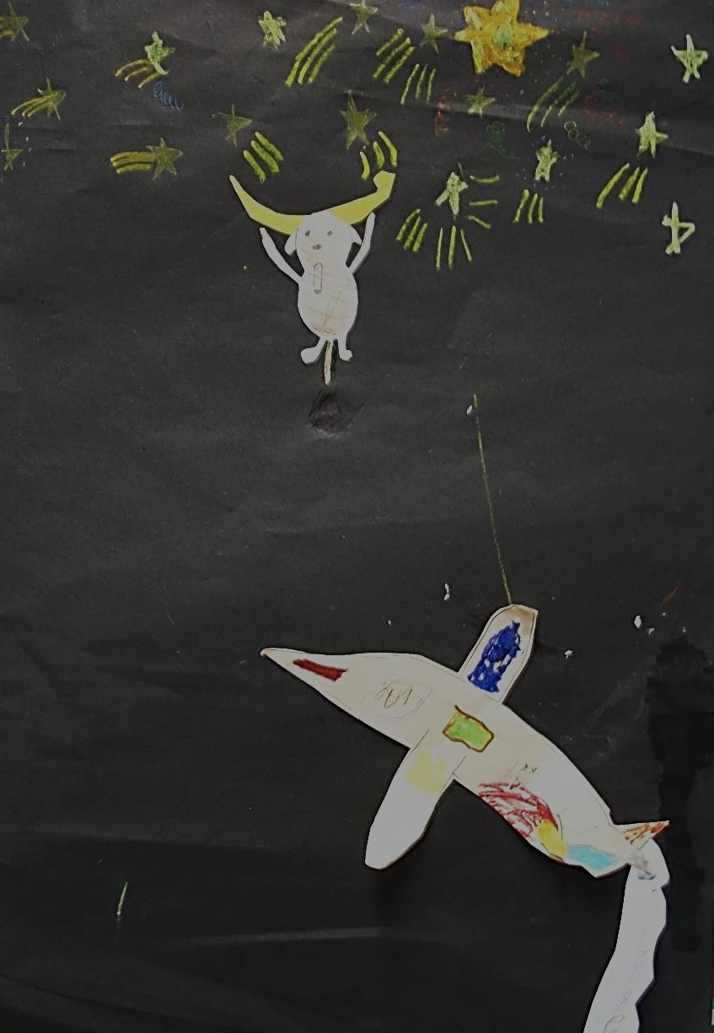
They go up in a special aeroplane.

Slide 11
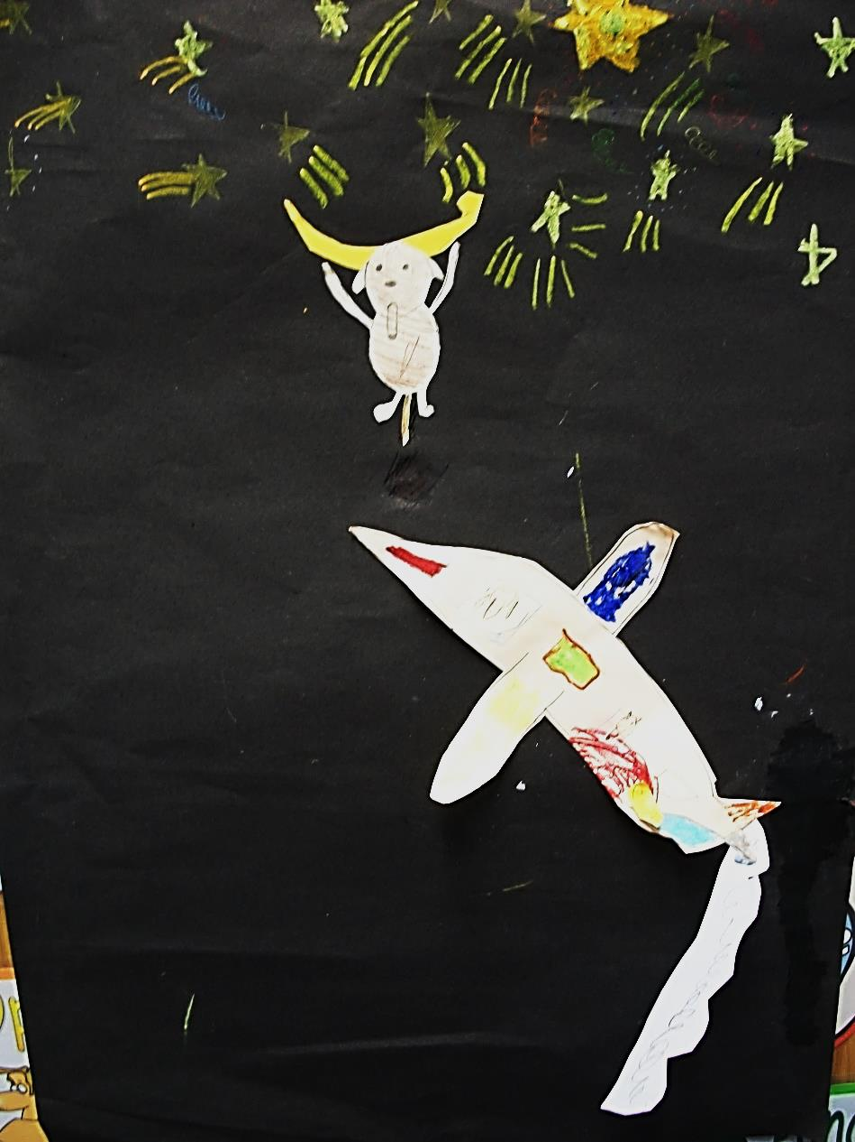
It is fuelled by Fizzy Pop.

Slide 12
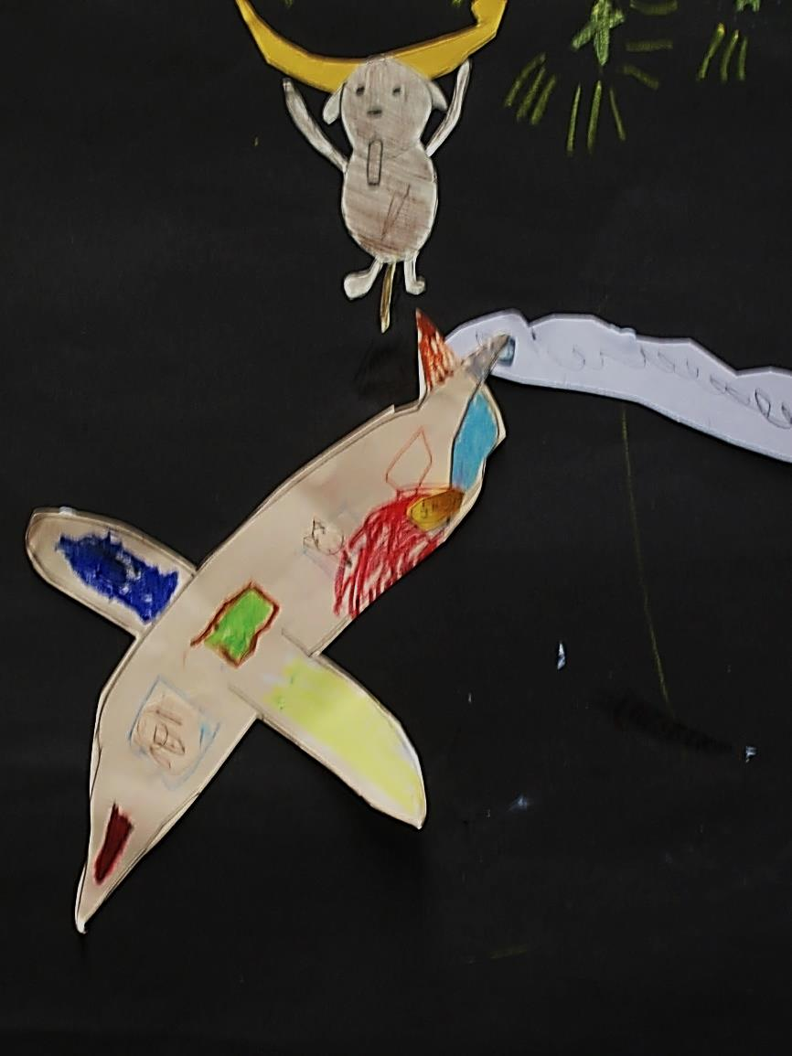
Big Wolf gets thirsty and...

Slide 13
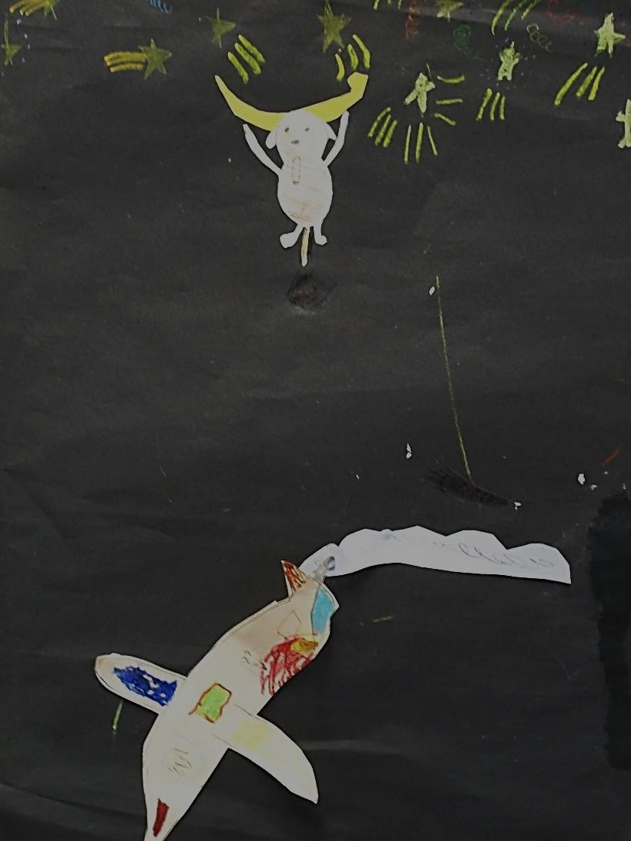
...the Fizzy Pop runs out!

Slide 14
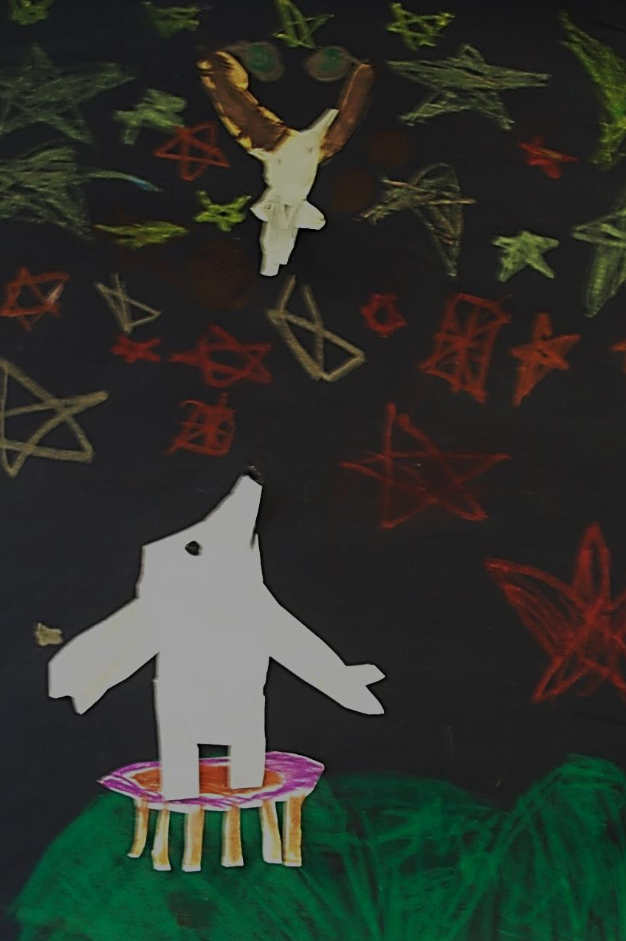
The Wolves fetch a trampoline...

Slide 15
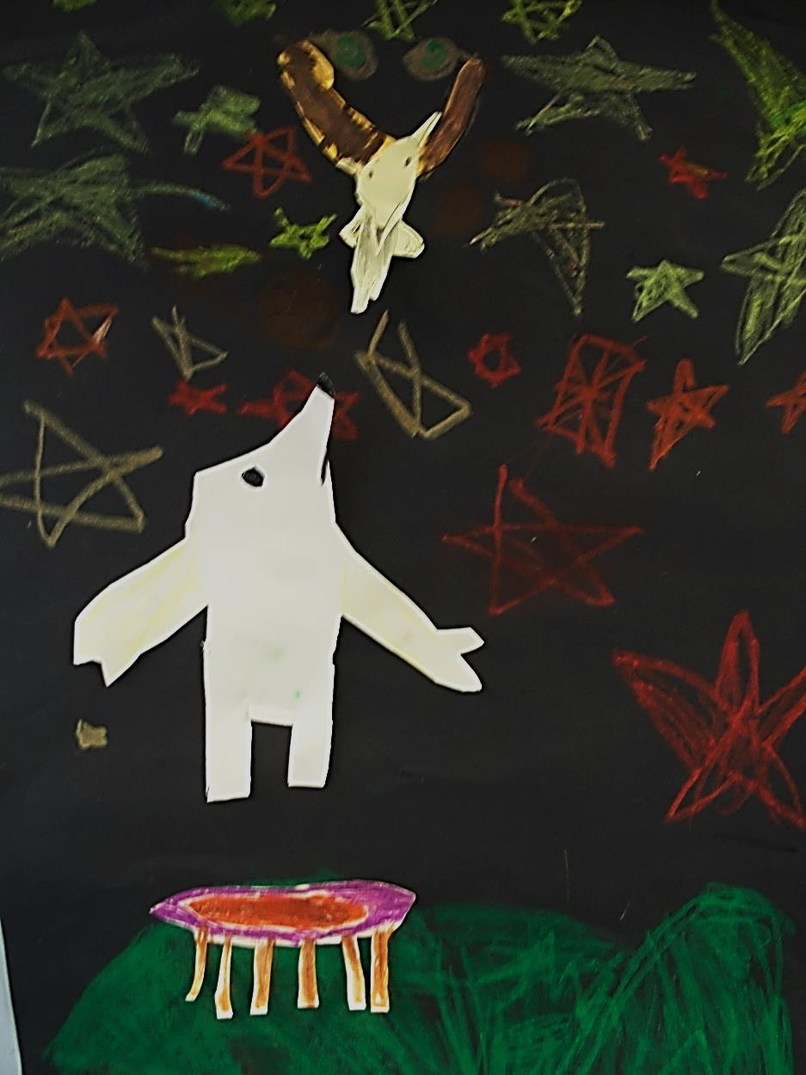
...and start to bounce higher...

Slide 16
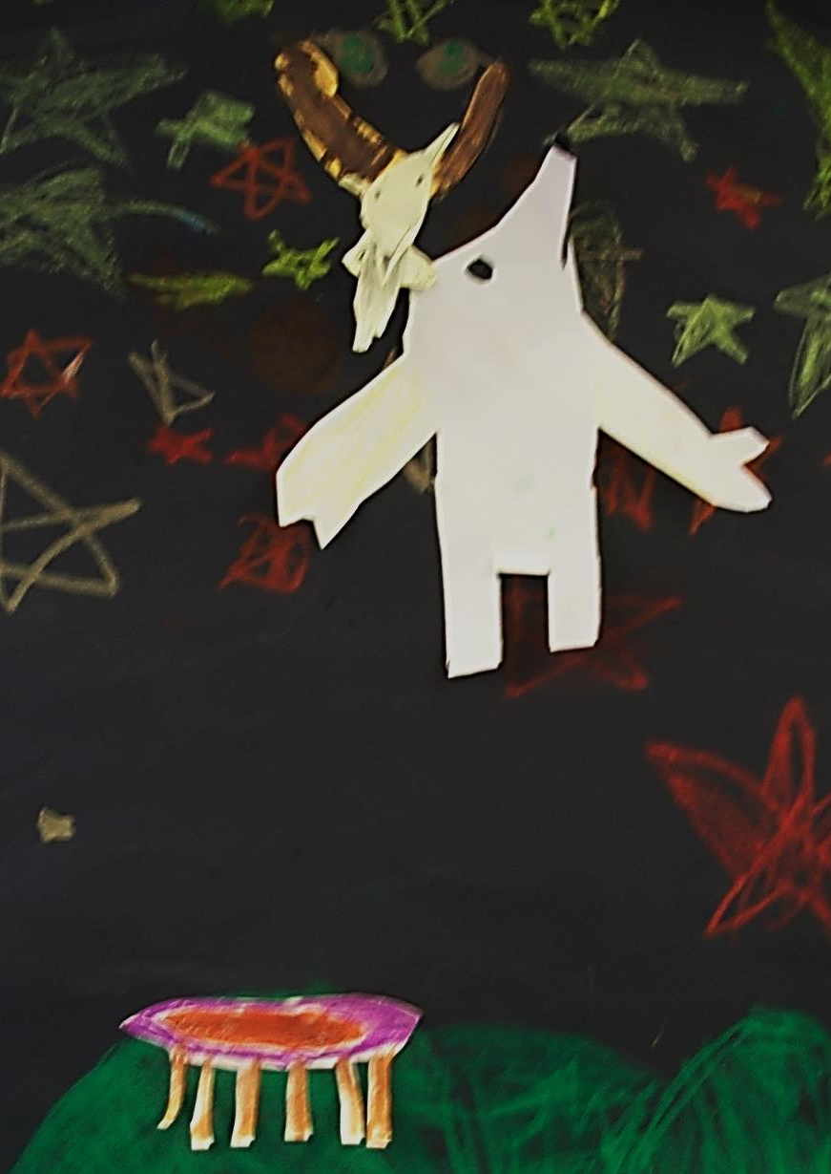
...and higher!

Slide 17
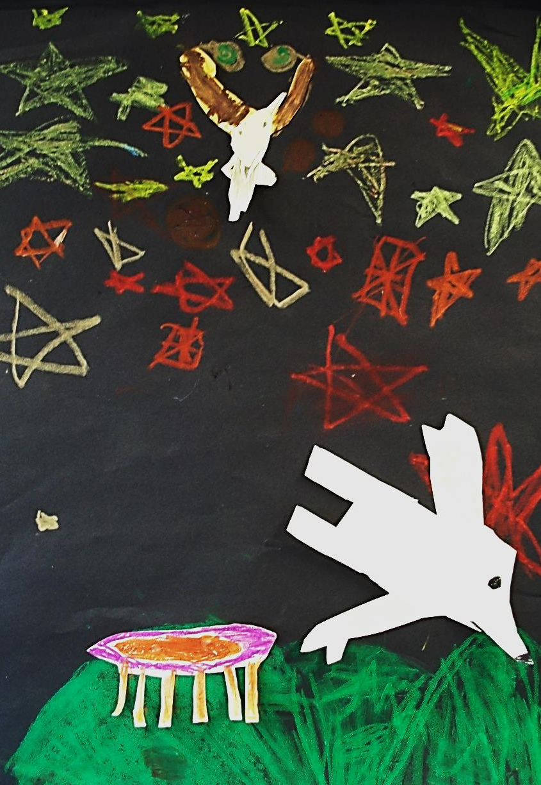
Oops!

Slide 18
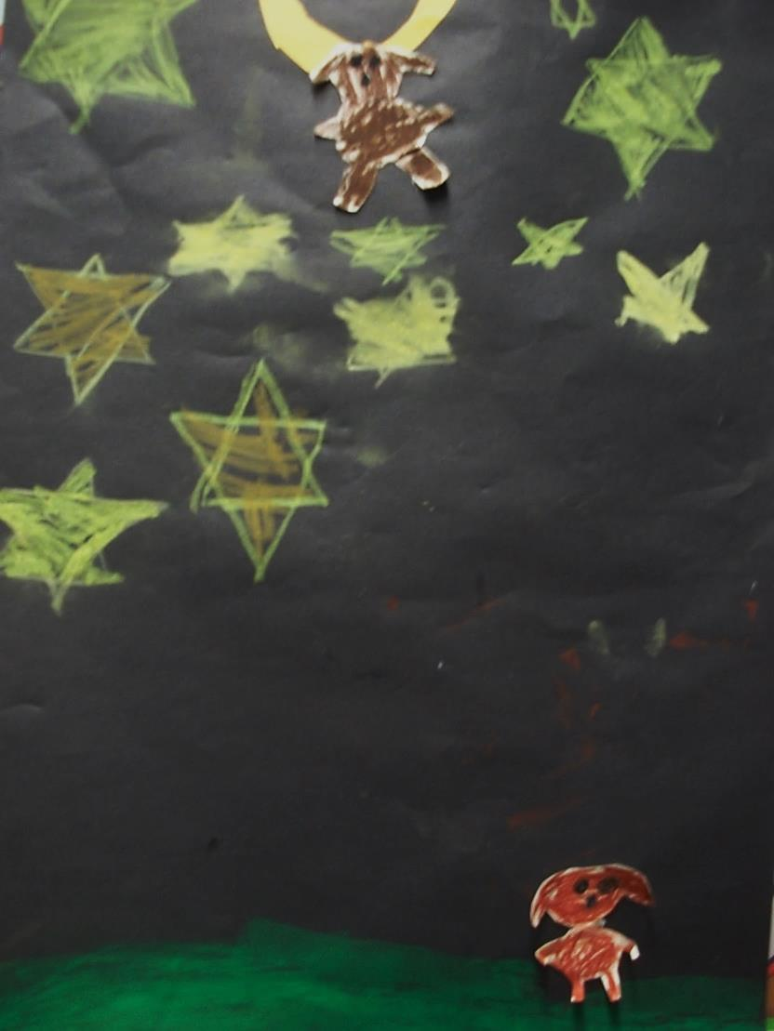
What will they try next?

Slide 19
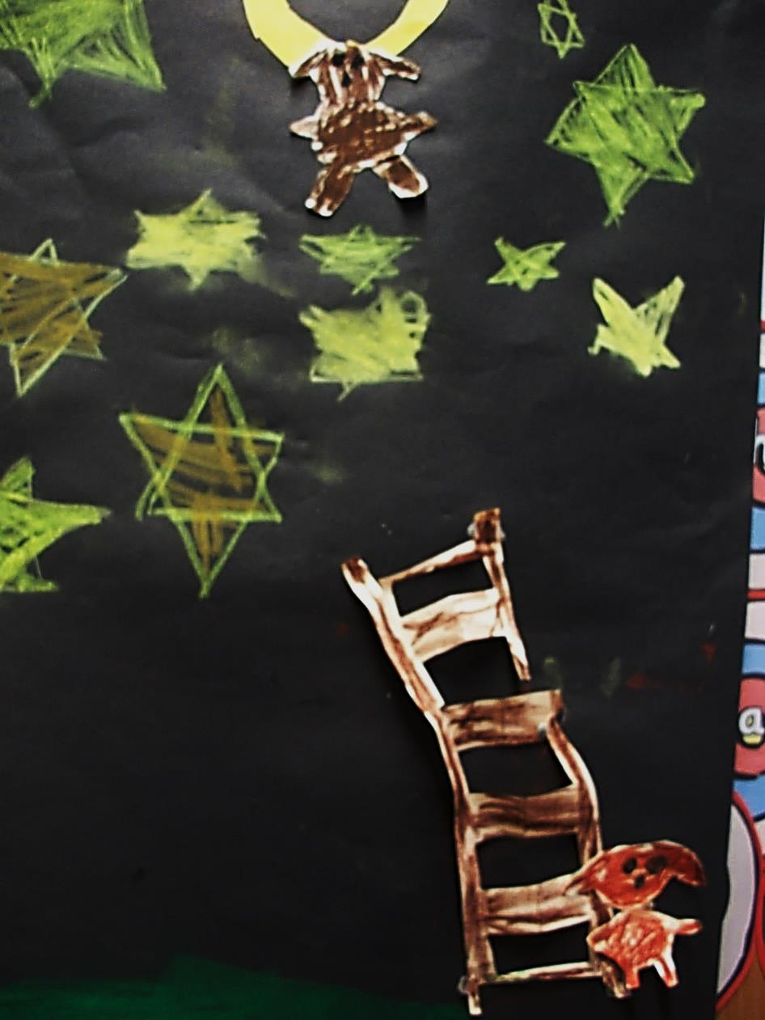
One Wolf fetches a ladder...

Slide 20
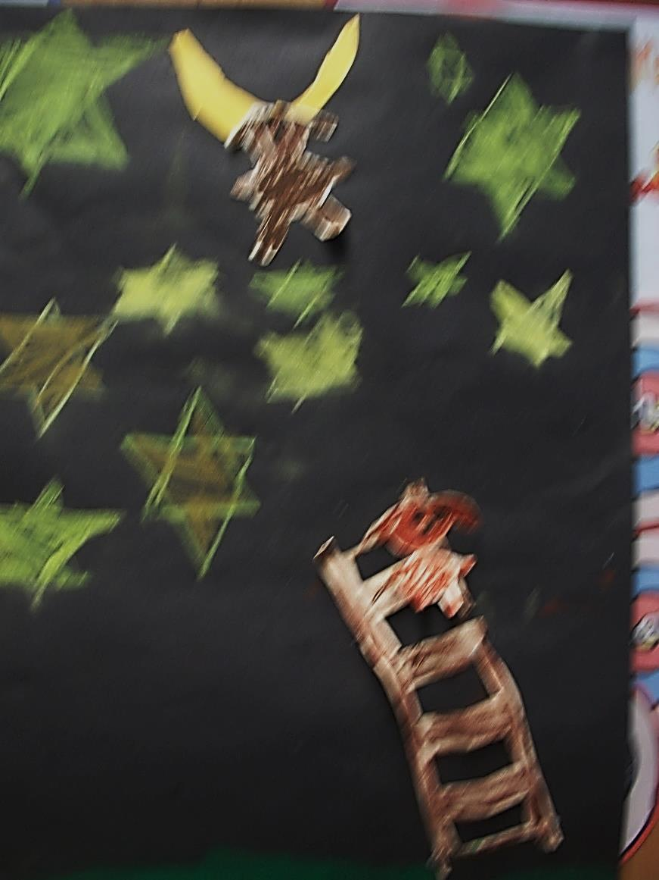
...but it is very wobbly!

Slide 21
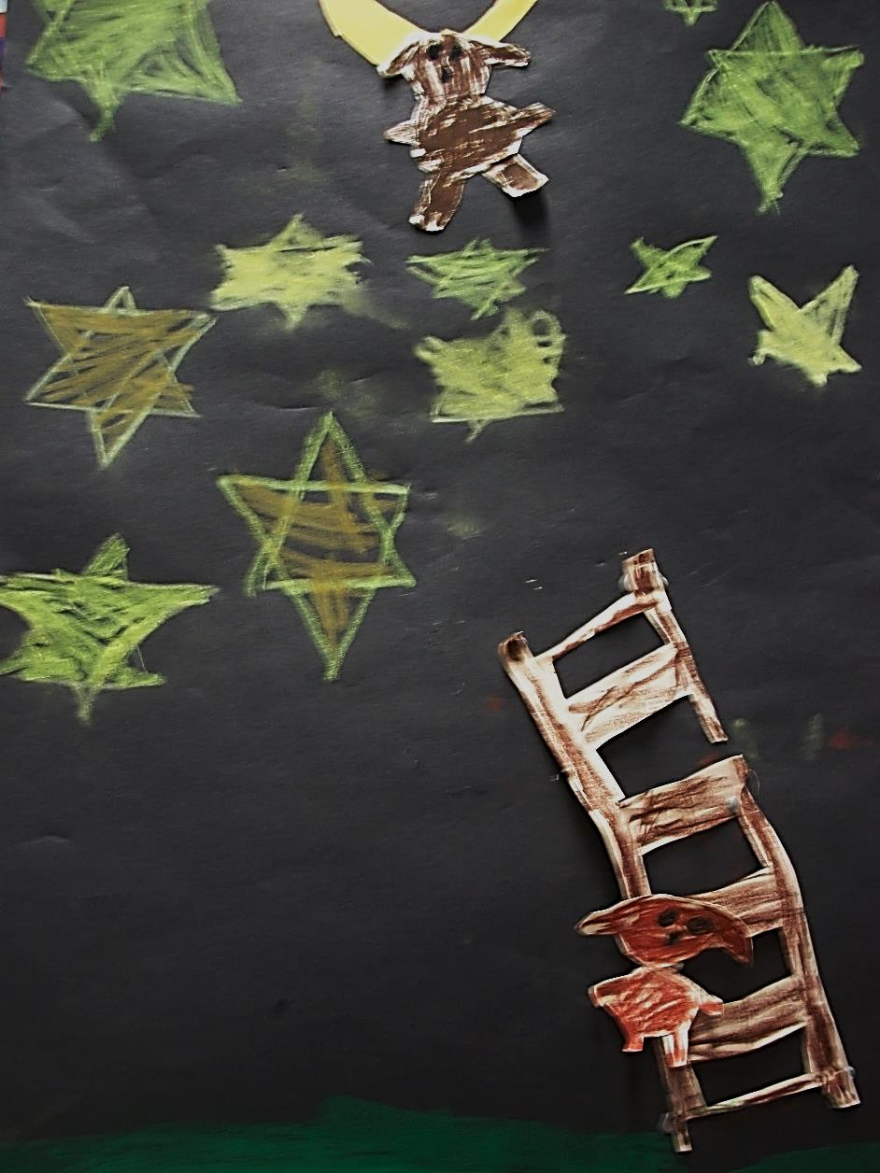
Big Wolf has to come down!

Slide 22
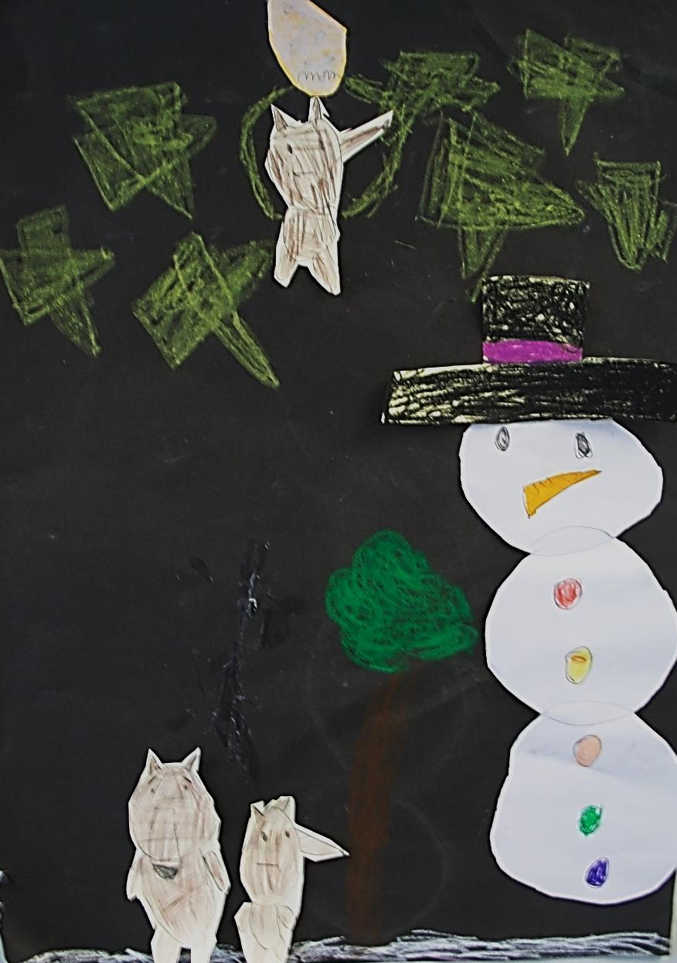
Maybe a giant snowman will do the trick...

Slide 23
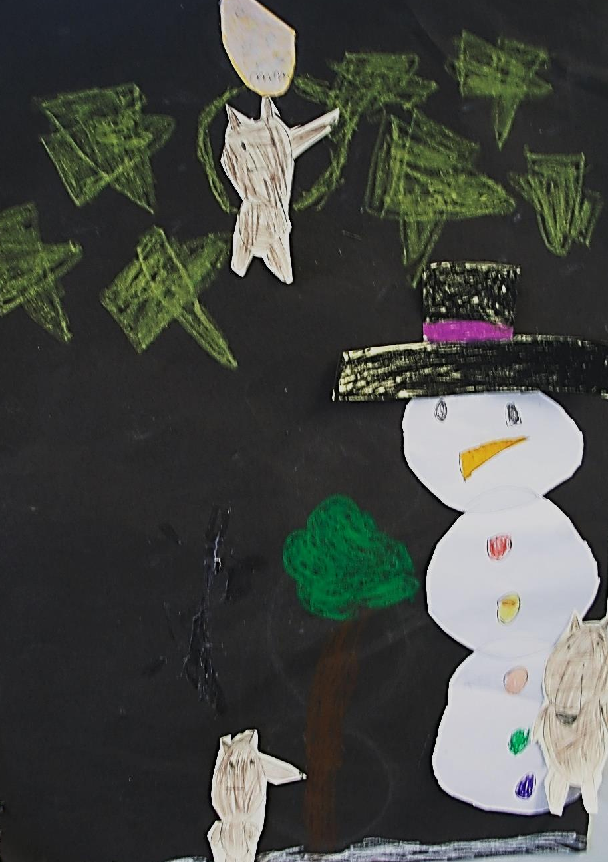
Big Wolf starts to climb.

Slide 24
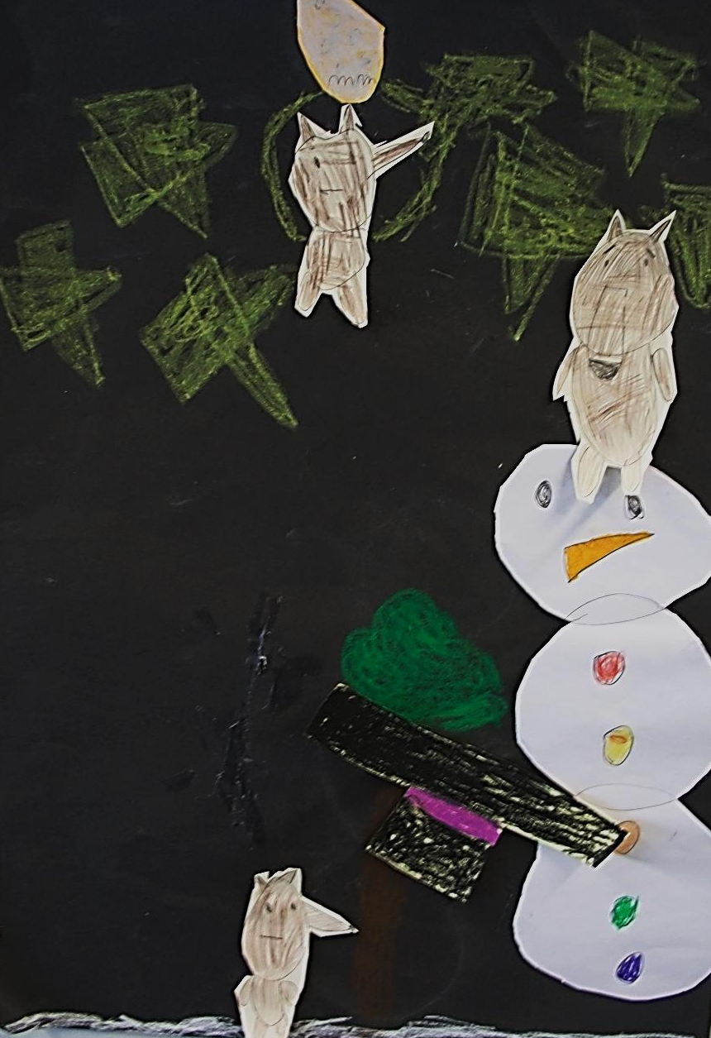
He is almost there when...

Slide 25
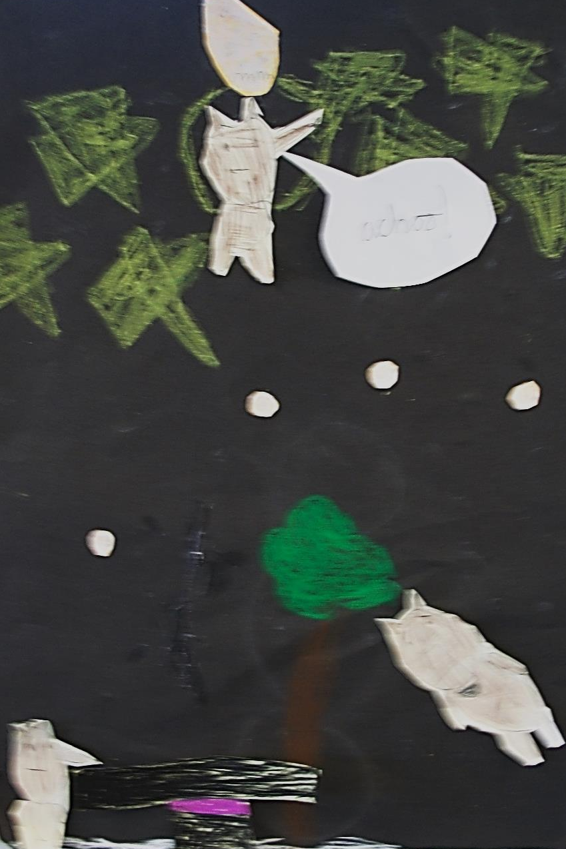
Bless You, Little Wolf!

Slide 26
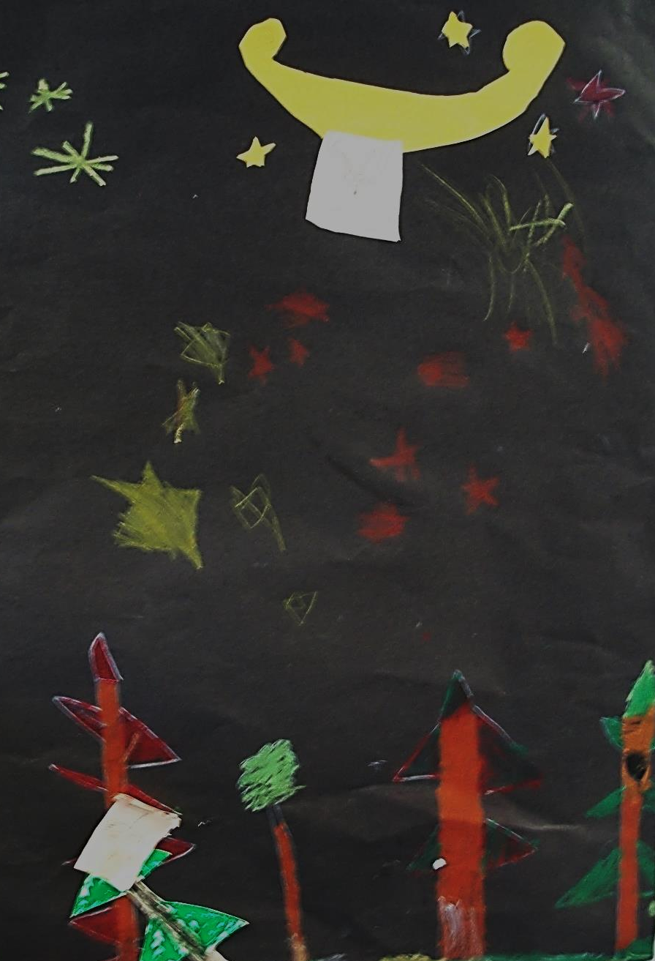
The Wolves try a catapault.

Slide 27
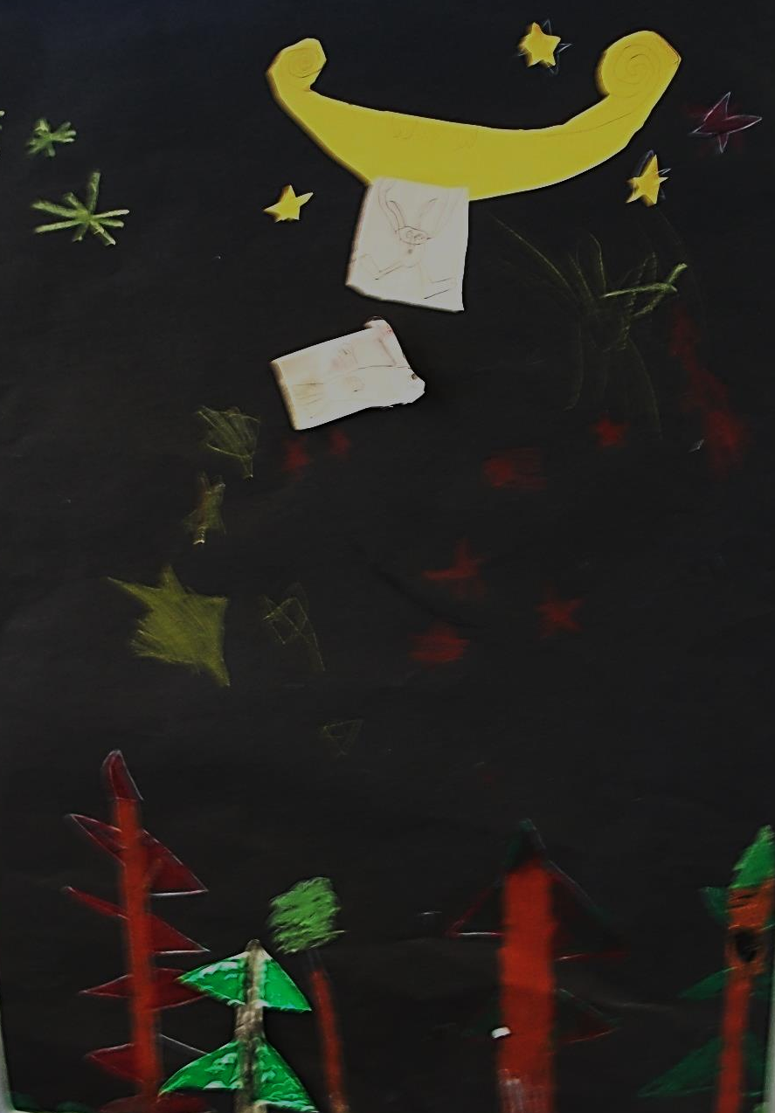
Aim... and FIRE!

Slide 28
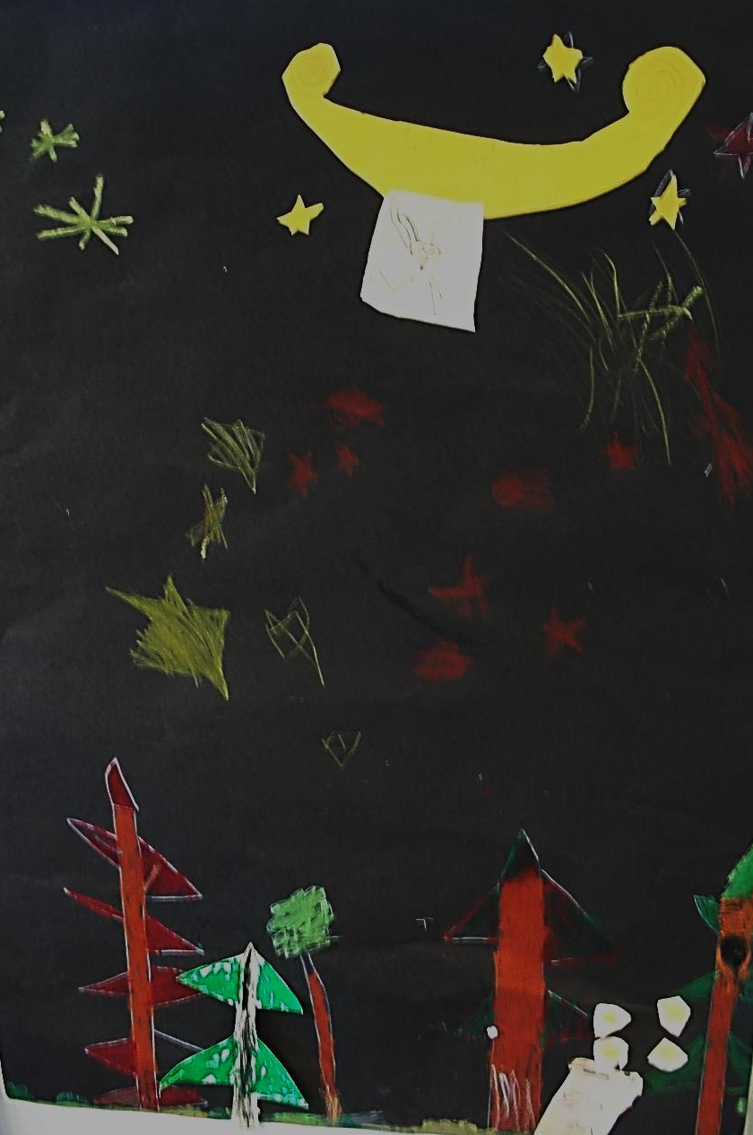
Oh dear! They missed again!

Slide 29
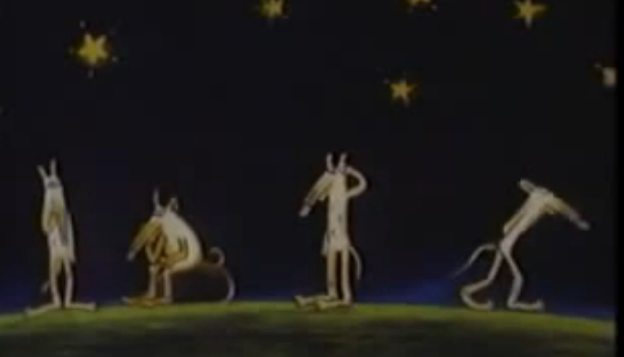
Nothing seems to work!

Slide 30
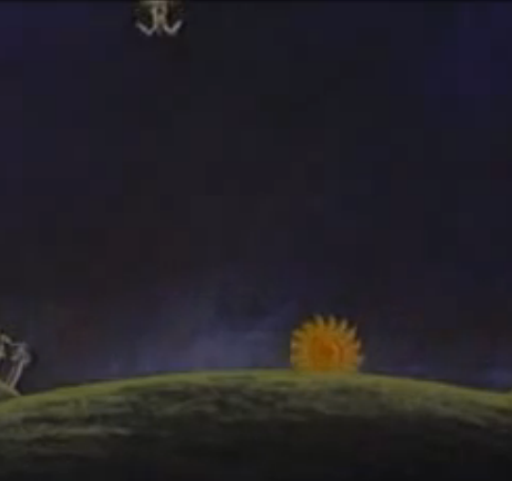
Finally the Sun comes up, the Moon goes down and...

Slide 31
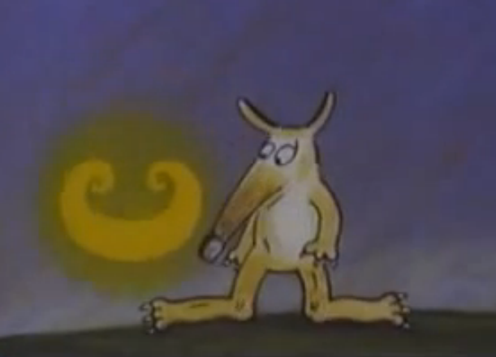
...Little Wolf is brought back
to Earth safe and sound!

Slide 32
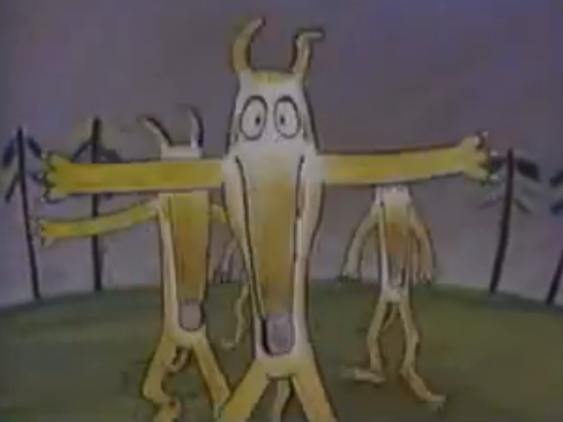
Welcome Back Little Wolf!

Slide 33
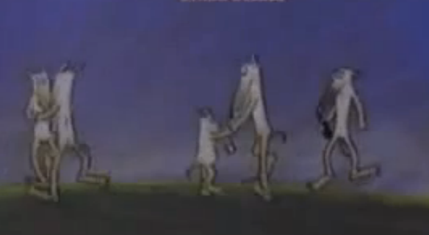
We are so glad you’re home!

Slide 34
Credits
Aeroplane: Ella, Kyla, Leonie
Trampoline: Emily, Joseph Su, Emily
Ladder: Finn D, Finley, Polly
Snowman: Marc, Orla, Sam
Catapault: Joseph Sa, Szymon, Thomas

