Slide 1
Year 2 Statutory Assessment Tests (SATs)
Information for Parents
Thursday 28th March 2019

Slide 2
Outline of the Session
What are SATs?
An overview of the tasks and tests
Teacher Assessment
The results
What can I do to help?

Slide 3
What are SATs?
Statutory Assessment Tests
A measure of how well the child is able to meet the demands of the National Curriculum 2014 at a given point in time
Children’s skills are assessed in English (Reading and Grammar) and Maths
English Writing and Science is assessed by Class Teachers
Assessments may be moderated by the Local Authority
Tests are used to inform Teacher Assessments.

Slide 4
Tests and Tasks
Phonics Screening Check: re-taken by those who didn’t reach the required standard in Year 1, and taken by those not in school in Year One, who didn’t take the Screening Check at a previous school.
Writing: assessed by teachers based on independent writing

Slide 5
Reading Tests
Format: combined text question booklet, separate text and question/answer paper, including practice questions and useful words
Assistance: No part of the paper can be read to groups or individuals, except for the practice questions and useful words.
For example:
‘I don’t understand the question’
“Read the question again and underline any key words that tell you what to do.”
‘What does this say?’
“ Read it again slowly, and use what you know about reading tricky words to help you work it out.”

Slide 6
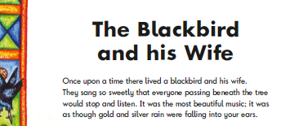
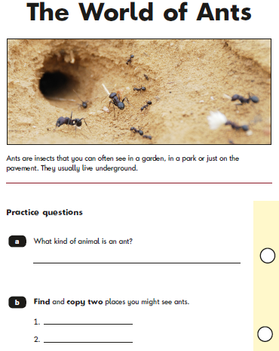
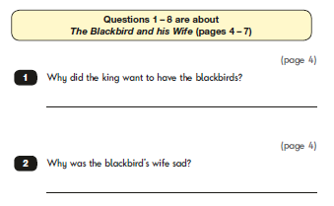
Reading Tests

Slide 7
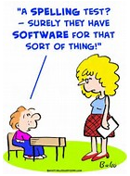
Spelling Test
Format: answer booklet containing 20 sentences with missing words. Children complete the sentences with the missing word during the test.
Timing: Minimum 12 second gap between spellings to give children sufficient time to write, target words may be repeated. Test should take approximately 15 minutes.
For example: ‘The word is face.’
‘I had a big smile on my face.’
‘The word is face.’

Slide 8
Grammar Test
Format: combined question and answer booklet
Timing: Approximately 20 minutes – not strictly timed.
Assistance: Questions may be read and re-worded as long as no subject-specific information is given away.
For example:
‘What does ‘comma’ mean?’
“I can’t tell you, but think hard and try to remember. We can talk about it after the test.”
Teachers must ensure that nothing we say or do could be interpreted as giving children an advantage in completing the tests.

Slide 9
Grammar Test

Slide 10
Mathematics Tests
Format: Two question and answer booklets:
Paper 1 Arithmetic, Paper 2 Reasoning
Paper 1 Arithmetic
Timing: Approximately 20 minutes – not strictly timed.
Assistance: children are not allowed calculators, rulers, number apparatus (cubes, number lines, hundred squares etc). If a child requests, questions and numbers may be read but not any mathematical symbols.
For example:
‘What does this sign mean?’
“I can’t tell you, but think hard and try to remember. We can talk about it after the test.”

Slide 11
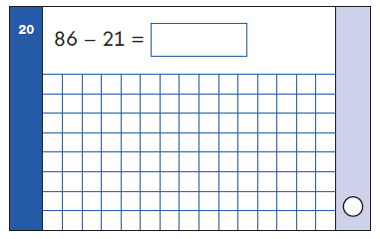
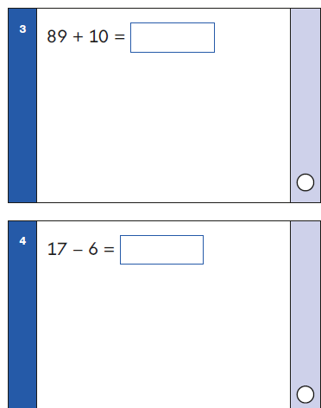
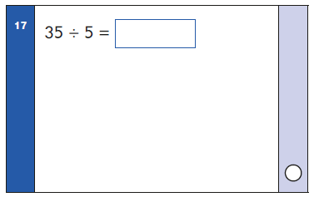
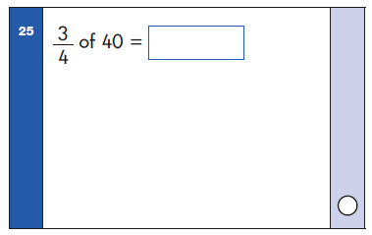
Mathematics Tests
Paper 1 Arithmetic

Slide 12
Mathematics Tests
Paper 2 Reasoning: includes 5 aural questions
Timing: Approximately 35 minutes – not strictly timed.
Assistance: Children are allowed rulers (cm and mm) but no other number apparatus or calculators. If a child requests, questions and numbers may be read but not any mathematical symbols.
Teachers may point to charts or diagrams, but cannot help in any interpretation of them.
For example: ‘What does ‘fraction’ mean?’
“I can’t tell you, but think hard and try to remember. We can talk about it after the test.”
Teachers must ensure that nothing we say or do could be interpreted as giving children an advantage in completing the tests.

Slide 13
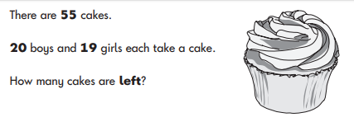
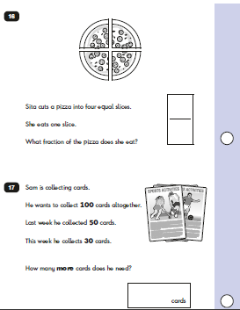
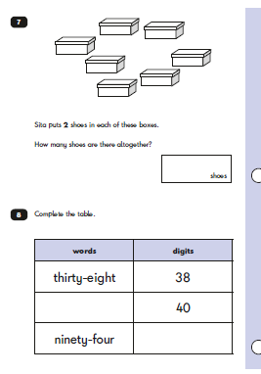
Mathematics Tests
Paper 2 Reasoning

Slide 14
Administering the Tests
Tests take place in May.
The are undertaken in the classroom or in a quiet area if in a smaller group.
Displays which may give unfair advantage are covered or removed.
Enough time is given to complete the test.
Children are familiar with test routines.
Tests are described as assessments which ‘tell teachers what we need to teach next,’ not as a measure of individual success.

Slide 15
Teacher Assessment
SATs are used to inform Teacher Assessment. This means that they are one part of the information we use to assess the standard at which a child is working. We also look at work in books, teacher observations and records.
SATs are marked in school, mark schemes are given and we follow national guidelines when administering and marking the tests.
The DfE will publish guidance on how to score the tests at a later date.
Teacher Assessments are moderated within school, within the local cluster of schools, and we may also receive a moderation visit from the Local Authority.

Slide 16
National Curriculum Standards
Assessment Framework Descriptors for 2019
Working pre-key stage 1- pupils working below the national curriculum assessment standard
Working towards the expected standard
Working at the expected standard
Working at greater depth within the expected standard
National ‘age-related expectations’ are published for the end of Key Stage One as a scaled score.

Slide 17
Results and Reporting
Parents/Carers are informed of which point their child is at within the age-related expectations: Reading, Writing, Mathematics and Science.
Teachers use teacher assessment for Science and Writing.
Phonics Screening Check results will be reported as ‘Working At’ the expected level or ‘Working Towards’.
Results will be provided with the End of Year Report.

Slide 18
What Can I Do to Help?
Reading
Read regularly, talk about the book, ask questions that go beyond literal recall: inference skills.
Writing
Practise spelling high frequency words and spelling patterns from phonics Phases 5 and 6 if children find them tricky .
Write when purposeful opportunities arise e.g. a letter to a family member, a postcard to a friend, a shopping list, an invitation, related to class reading book.
Mathematics
Find opportunities for your child to use numbers in everyday situations and encourage them to work out calculations in their head.
Practise addition and subtraction facts, times tables and related division facts.
Learning
Ensure attendance and punctuality is good.
Reasonable bedtimes so children are rested, alert and ready to learn.
Talk with your child about their learning in school.

Slide 19
Thank you!
A copy of this presentation will be available on the class pages sidebar on the school website: www.morley.cambs.sch.uk
Standards and Testing Agency have published a ‘Information for parents’ leaflet (2018 version currently)
Individual concerns: please make an appointment with your child’s class teacher.
This video summarises the main points of today’s discussion:
https://www.youtube.com/watch?v=dVlrdqh_J6Y

